Slide 1
DP-600: Microsoft Fabric Analytics Engineer
Day 1
Notes:
Instructor notes and guidance.
This space has been left deliberately blank

Slide 2
Explore end-to-end analytics with Microsoft Fabric
Notes:
aka.ms/fabric-intro
Before delivering this presentation, review the associated module on Microsoft Learn.
The estimated time to present these slides is 45 minutes.

Slide 3
Learning objectives
Describe end-to-end analytics in Microsoft Fabric.
Understand data teams and roles that use Fabric.
Describe how to enable and use Fabric.

Slide 4





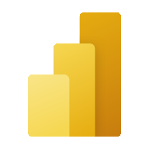

Microsoft Fabric
Data Factory
Data Engineering
Data Warehouse
Data Science
Real-Time Intelligence
Power BI
Data Factory: Data integration combining Power Query with the scale of Azure Data Factory to move and transform data.
Data Engineering: Data engineering with a Spark platform for data transformation at scale.
Data Warehouse: Data warehousing with industry-leading SQL performance and scale to support data use.
Data Science: Data science with Azure Machine Learning and Spark for model training and execution tracking in a scalable environment.
Real-Time Intelligence: Real-time Intelligence to query and analyze large volumes of data in real-time.
Power BI: Business intelligence for translating data to decisions.
OneCopy is a key component of OneLake that allows you to read data from a single copy, without moving or duplicating data.
OneLake
UNIFIED
SaaS product experience
Security and governance
Compute and storage
Business model
Notes:
This is a build slide. Scalable analytics can be complex, fragmented, and expensive. With Microsoft Fabric, you don't have to spend all of your time combining various services from different vendors. Instead, you can use a single product that is easy to understand, set up, create, and manage. Fabric is a unified software-as-a-service (SaaS) offering, with all your data stored in a single open format in OneLake.
Click to remove descriptions of the experiences. OneLake is Fabric's lake-centric architecture that provides a single, integrated environment for data professionals and the business to collaborate on data projects. Think of it like OneDrive for data; OneLake combines storage locations across different regions and clouds into a single logical lake, without moving or duplicating data. Data can be stored in any file format in OneLake and can be structured or unstructured. For tabular data, the analytical engines in Fabric will write data in delta format when writing to OneLake. All engines will know how to read this format and treat delta files as tables no matter which engine writes it.

Slide 5


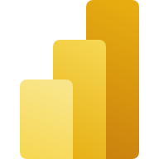





Data teams and Fabric
Fabric’s unified management and governance make it easier for data professionals to work together.
Data Engineers
Analytics Engineers
Data Scientists
Data Analysts
Decision Makers
Data Factory
Data Warehouse
Data Factory
Power BI
Data Science
Azure ML
Power BI
Power BI
Microsoft 365
Data Engineering
Real-time intelligence
Data Engineering
Data Warehouse
Data Stewards
Notes:
Microsoft Fabric's unified management and governance make it easier for data professionals to work together on data projects. Fabric removes data silos and the need for access to multiple systems, enhancing collaboration between data professionals. The roles on a data team likely look different depending on your organization. Generally speaking:
Data Engineers are responsible for building, managing, and securing the data pipelines that ingest, transform, and store data from various sources. They use tools such as Data Factory, Data Warehouse, Data Engineering (lakehouse), and Real-Time Intelligence to create scalable and reliable data solutions.
Analytics Engineers are responsible for designing, developing, and testing the data models and analytics logic that power the data products and insights. They use tools such as as Data Factory, Data Warehouse, Data Engineering (lakehouse), and Power BI to create and deploy analytics solutions.
Data Scientists are responsible for applying advanced statistical and machine learning techniques to discover patterns, trends, and predictions from data. They use tools such as Azure Machine Learning, and the Data Science experience to create and operationalize data science models and applications.
Data Analysts are responsible for exploring, analyzing, and visualizing data to answer business questions and generate insights. They use tools such as Power BI and Excel to create and share interactive reports and dashboards.
Decision Makers are responsible for using data and insights to make informed and strategic decisions that drive business outcomes. They use tools such as Power BI, Excel, Power Apps, and Power Automate to consume and act on data and insights from various sources and scenarios.
All roles should act as data stewards because data needs to be properly managed, governed, and used to drive business value and innovation.

Slide 6
Enable and use Microsoft Fabric
Fabric must be enabled in your tenant by either:
Fabric admin (formerly known as Power BI admin)
Power Platform admin
Microsoft 365 admin
Workspaces must then be assigned to Premium per capacity or Fabric license mode.
Notes:
All Fabric items (lakehouses, notebooks, pipelines, etc.) are stored in OneLake and accessed via Fabric workspaces.

Slide 7
Knowledge check
1
Which of the following is a key benefit of using Microsoft Fabric in data projects?
It allows data professionals to work on data projects independently, without the need for collaboration
It requires duplication of data across different systems and teams to ensure data availability
It provides a single, integrated environment for data professionals and the business to collaborate on data projects
2
How do compute engines in Fabric interact with data stored in OneLake?
Compute engines can directly access data in OneLake without the need for duplication or movement
OneLake automatically converts data into csv format for seamless integration with compute engines
Compute engines in Fabric can only interact with a limited subset of data formats within OneLake
3
Which of the following Fabric experiences is used to move and transform data?
Data Science
Data Warehousing
Data Factory
Notes:
Allow students a few minutes to think about the questions, and then use the animated slide to reveal the correct answers.

Slide 8

Further reading
Introduction to end-to-end analytics using Microsoft Fabric
https://aka.ms/fabric-intro
Notes:
Encourage students to review the online material on Microsoft Learn on which this presentation is based.

Slide 9
Get started with lakehouses in Microsoft Fabric
Notes:
https://aka.ms/fabric-lakehouse Before delivering this presentation, review the associated module on Microsoft Learn.
The estimated time to present these slides is 45 minutes.

Slide 10

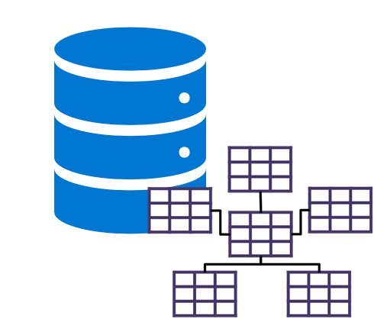

What is a lakehouse?
Data Lake
Data Warehouse
Scalable, distributed file storage​
Flexible schema-on-read semantics​
Big data technology compatibility​
Relational schema modeling​
SQL-based querying​
Proven basis for reporting and analytics​
Notes:
This is a build slide.
The foundation of Microsoft Fabric is a Lakehouse, which is built on top of the OneLake scalable storage layer and uses Apache Spark and SQL compute engines for big data processing. Click for descriptions.
A Lakehouse is a unified platform that combines:
The flexible and scalable storage of a data lake
The ability to query and analyze data of a data warehouse
A Lakehouse presents as a database and is built on top of a data lake using Delta format tables. Lakehouses combine the SQL-based analytical capabilities of a relational data warehouse and the flexibility and scalability of a data lake. Lakehouses store all data formats and can be used with various analytics tools and programming languages. As cloud-based solutions, lakehouses can scale automatically and provide high availability and disaster recovery. Benefits of a lakehouse:
- Utilizes Spark and SQL engines for large-scale data processing and analytics, including machine learning and predictive modeling.
- Adopts a schema-on-read format, allowing flexible schema definition as needed, rather than relying on a predefined schema.
- Supports ACID transactions through Delta Lake formatted tables, ensuring data consistency and integrity.
- Provides a centralized location for data engineers, data scientists, and data analysts to access and utilize data.

Slide 11

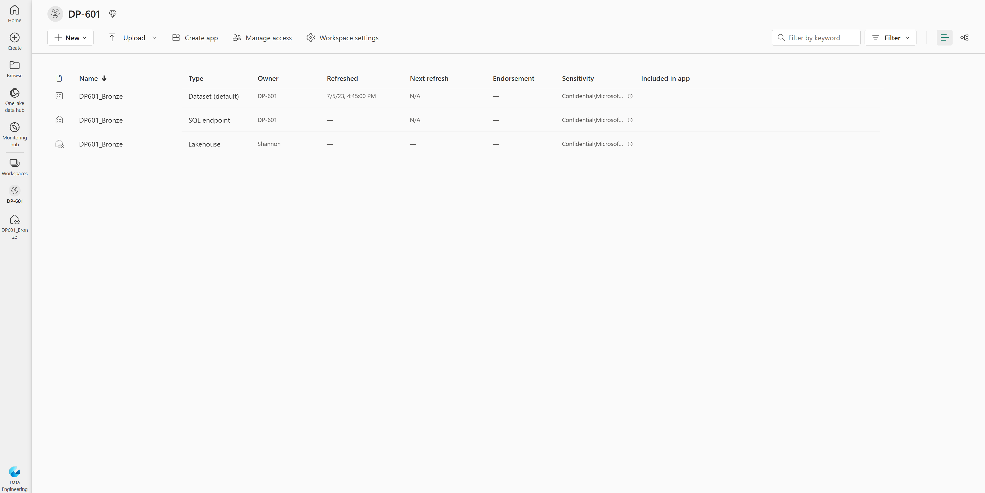
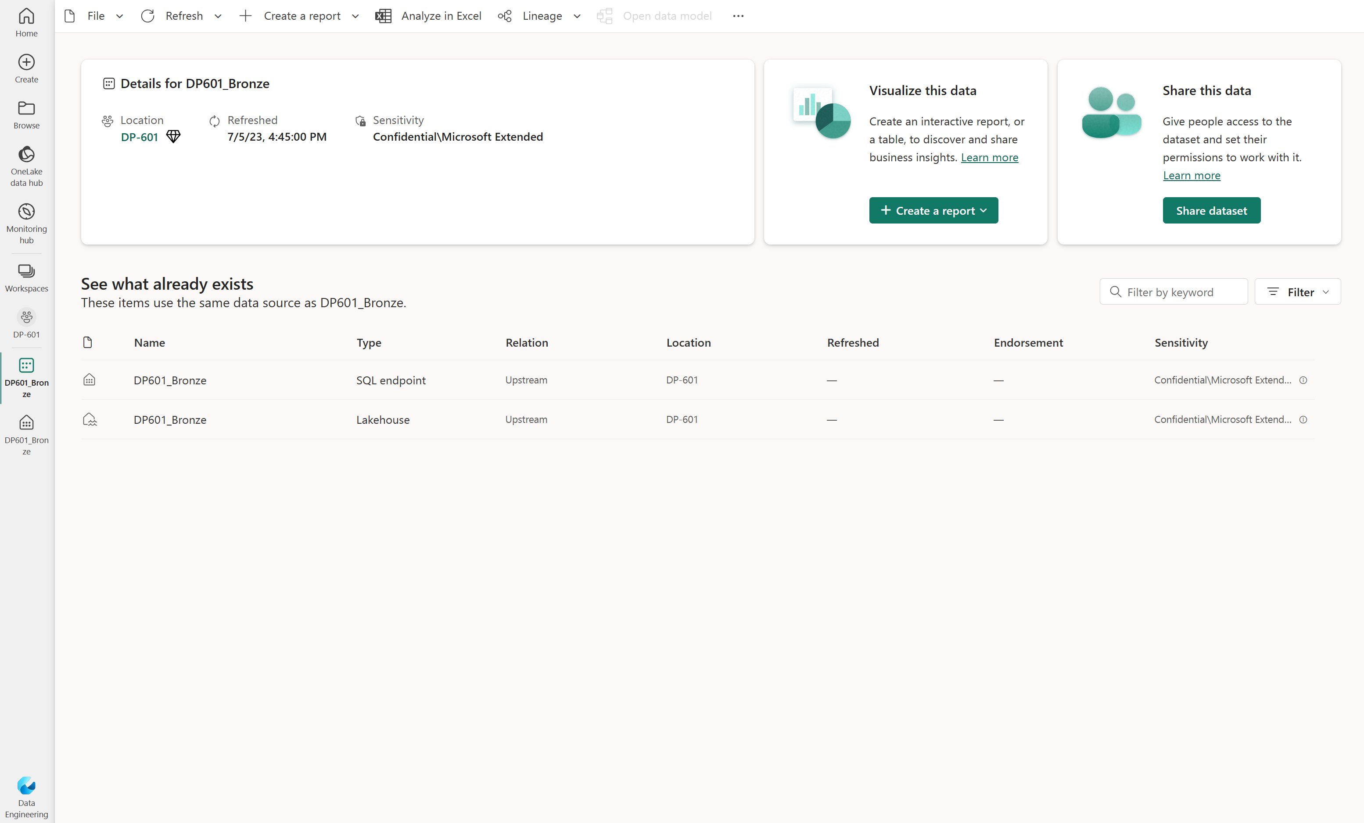
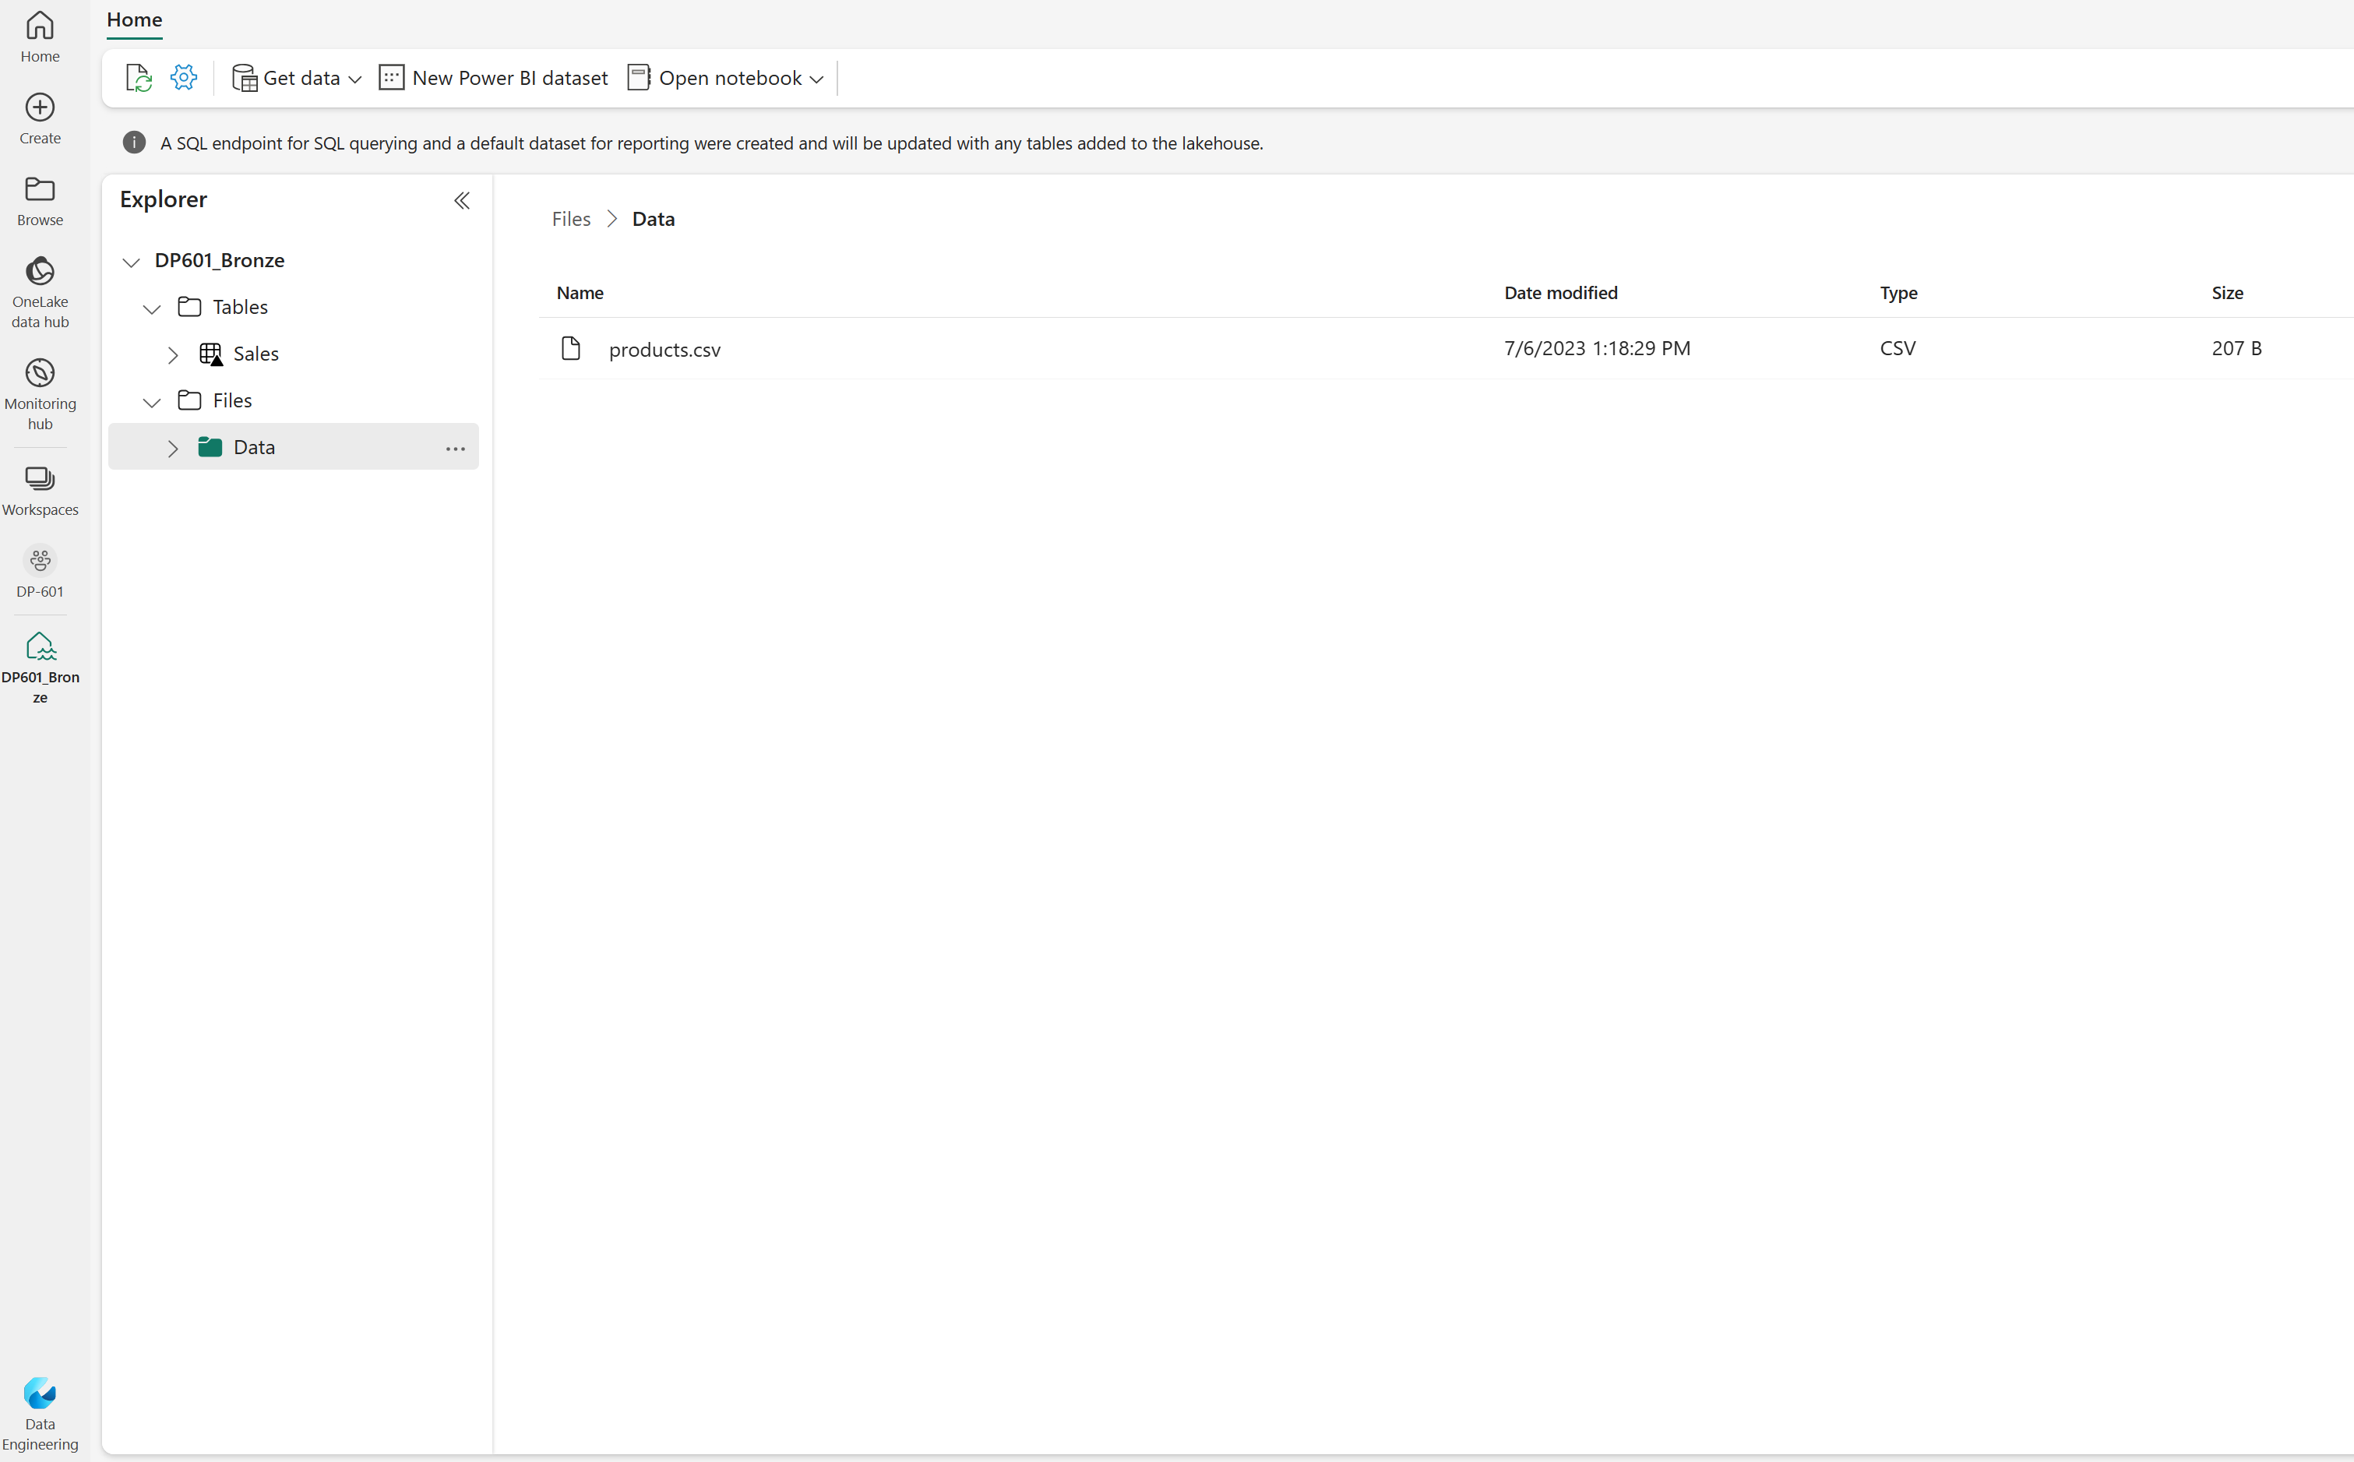
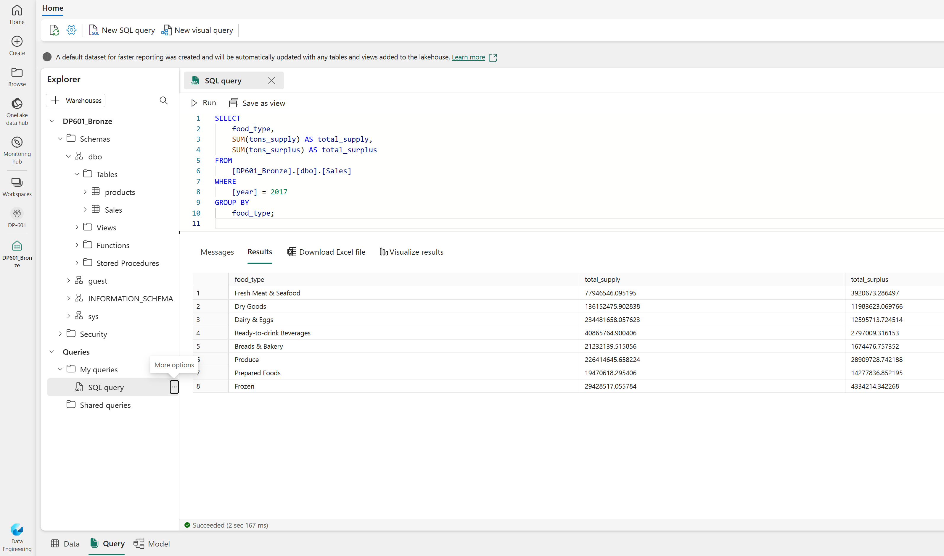
Work with a Fabric lakehouse
Notes:
This is a build slide.
In Microsoft Fabric, you can create a lakehouse in the Data engineering experience in any Fabric workspace. After creating a lakehouse, you can load data - in any common format - from various sources; including local files, databases, or APIs.
Lakehouses are created and configured in the Data Engineering experience. Click to see the Fabric items that are created when you create a lakehouse. The creation of a single lakehouse produces three named items in the Fabric-enabled workspace:
Lakehouse is the lakehouse storage and metadata, where you interact with files, folders, and table data.
A semantic model (default) is an automatically created data model based on the tables in the lakehouse. Power BI reports can be built from the semantic model.
The SQL analytics endpoint is a read-only SQL analytics endpoint through which you can connect and query data with Transact-SQL.

Slide 12
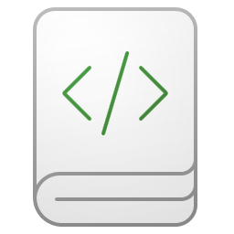
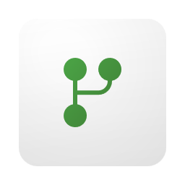


Load data into a lakehouse
Ingest and connect to data sources to transform and load for analytics.
Notebooks
Dataflows Gen2
Pipelines
Shortcuts
Notes:
Ingest data into a lakehouse
Ingesting data into your lakehouse is the first step in your ETL process. Use any of the following methods to bring data into your lakehouse.
Upload: Upload local files.
Dataflows Gen2: Import and transform data using Power Query.
Notebooks: Use Apache Spark to ingest, transform, and load data.
Data Factory pipelines: Use the Copy data activity.
This data can then be loaded directly into files or tables. Consider your data loading pattern when ingesting data to determine if you should load all raw data as files before processing or use staging tables.
Spark job definitions can also be used to submit batch/streaming jobs to Spark clusters. By uploading the binary files from the compilation output of different languages (for example, .jar from Java), you can apply different transformation logic to the data hosted on a lakehouse. Besides the binary file, you can further customize the behavior of the job by uploading more libraries and command line arguments.
Access data using shortcuts
Another way to access and use data in Fabric is to use shortcuts. Shortcuts enable you to integrate data into your lakehouse while keeping it stored in external storage.
Shortcuts are useful when you need to source data that's in a different storage account or even a different cloud provider. Within your lakehouse you can create shortcuts that point to different storage accounts and other Fabric items like data warehouses, KQL databases, and other lakehouses.
Source data permissions and credentials are all managed by OneLake. When accessing data through a shortcut to another OneLake location, the identity of the calling user will be utilized to authorize access to the data in the target path of the shortcut. The user must have permissions in the target location to read the data.
Shortcuts can be created in both lakehouses and KQL databases, and appear as a folder in the lake. This allows Spark, SQL, Real-Time intelligence and Analysis Services to all utilize shortcuts when querying data.

Slide 13






Explore, transform, and visualize data in the lakehouse
Tools and techniques to explore and transform data:
Apache Spark
Notebooks
Spark Job Definitions
SQL analytics endpoint
Dataflows Gen2
Data Pipelines
Visualize lakehouse data using Power BI
Notes:
After loading data into the lakehouse, you can use various tools and techniques to explore and transform it, including:
Apache Spark: Each Fabric lakehouse can use Spark pools through Notebooks or Spark Job Definitions to process data in files and tables in the lakehouse using Scala, PySpark, or Spark SQL.
Notebooks: Interactive coding interfaces in which you can use code to read, transform, and write data directly to the lakehouse as tables and/or files.
Spark Job Definitions: On-demand or scheduled scripts that use the Spark engine to process data in the lakehouse.
SQL analytics endpoint: Each lakehouse includes a SQL analytics endpoint through which you can run Transact-SQL statements to query, filter, aggregate, and otherwise explore data in lakehouse tables.
Dataflows Gen2: In addition to using a dataflow to ingest data into the lakehouse, you can create a dataflow to perform subsequent transformations through Power Query, and optionally land transformed data back to the Lakehouse.
Data Pipelines: Orchestrate complex data transformation logic that operates on data in the lakehouse through a sequence of activities (such as dataflows, Spark jobs, and other control flow logic).

Slide 14
Exercise
Create and ingest data with a Microsoft Fabric lakehouse
30 minutes
Notes:
https://aka.ms/mslearn-fabric-lakehouse The estimated time to complete this exercise is 30 minutes.

Slide 15
Knowledge check
What is a Microsoft Fabric lakehouse?
1
A relational database based on the Microsoft SQL Server database engine.
A hierarchy of folders and files in Azure Data Lake Store Gen2.
An analytical store that combines the file storage flexibility of a data lake with the SQL-based query capabilities of a data warehouse.
2
You want to include data in an external Azure Data Lake Store Gen2 location in your lakehouse, without the requirement to copy the data. What should you do?
Create a Data pipeline that uses a Copy Data activity to load the external data into a file.
Create a shortcut.
Create a Dataflow Gen2 that extracts the data and loads it into a table.
3
You want to use Apache Spark to interactively explore data in a file in the lakehouse. What should you do?
Create a notebook.
Switch to the SQL analytics endpoint mode.
Create a Dataflow Gen2.
Notes:
Allow students a few minutes to think about the questions, and then use the animated slide to reveal the correct answers.

Slide 16
Recap
In this section, we covered:
Lakehouse architecture.
How to work with a lakehouse.
Data ingestion, transformation, and exploration tools.

Slide 17
Further reading
Get started with lakehouses in Microsoft Fabric
https://aka.ms/fabric-lakehouse
Notes:
Encourage students to review the online material on Microsoft Learn on which this presentation is based.

Slide 18
Ingest data with Dataflow Gen2 in Microsoft Fabric
Notes:
aka.ms/fabric-dataflow Before delivering this presentation, review the associated module on Microsoft Learn.
The estimated time to present these slides is 30 minutes.

Slide 19
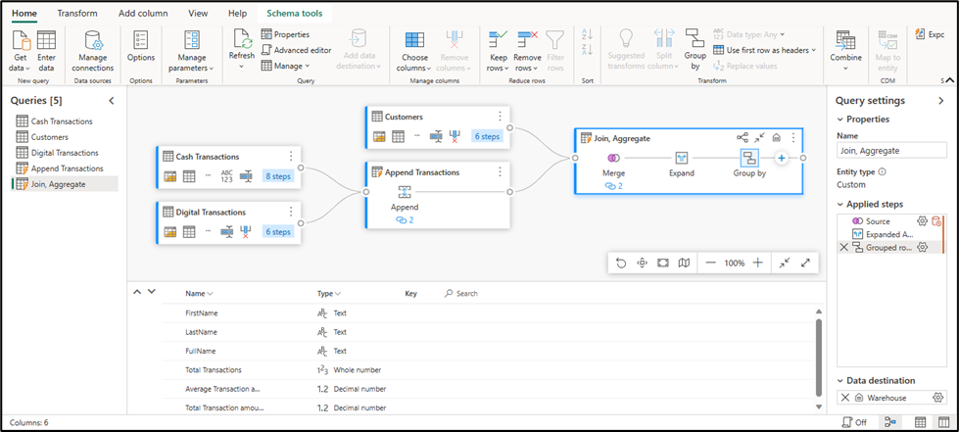
Understand Dataflow Gen2
Low-code graphical environment for defining ETL solutions
Extract data from multiple sources, transform it, and load it into a destination
Run dataflows independently or as an activity in a Pipeline
Notes:
There are two primary high-level features Data Factory implements: dataflows and pipelines.
1. Dataflow Gen2 enable you to leverage a low-code interface and 300+ data and AI-based transformations, letting you transform data easier and with more flexibility than any other tool.
2. Data Pipelines enable you to leverage rich out-of-the-box data orchestration capabilities to compose flexible data workflows that meet your enterprise needs. You can learn more about their capabilities in the Data Factory Spotlight: data pipelines blog post. What is a dataflow?
Dataflows are a type of cloud-based ETL (Extract, Transform, Load) tool for building and executing scalable data transformation processes.
Dataflow Gen2 allow you to extract data from various sources, transform it using a wide range of transformation operations, and load it into a destination. Using Power Query Online also allows for a visual interface to perform these tasks.
The ability to specify an output destination along with enhanced compute time are what set Dataflow Gen2 apart from their predecessor.
Dataflows allow you to promote reusable ETL logic that prevents the need to create more connections to your data source. Dataflows offer a wide variety of transformations, and can be run manually, on a refresh schedule, or as part of a Data Pipeline orchestration.
How does Gen2 differ from Gen1?
Dataflow Gen2 in Fabric is the evolution of Dataflow, redesigned from the ground up with more powerful compute engines, data movement capabilities to help you load data to several Fabric and Azure data destinations. Dataflows Gen2 is only available in Fabric (not in Power BI without a Fabric license/trial).

Slide 20
Dataflow Gen2 benefits and limitations
Benefits:
Limitations:
Allow self-service users access to a subset of data warehouse separately.
Optimize performance with dataflows, which enable extracting data once for reuse, reducing data refresh time for slower sources.
Simplify data source complexity by only exposing dataflows to larger analyst groups.
Ensure consistency and quality of data by enabling users to clean and transform data before loading it to a destination.
Dataflows aren't a replacement for a data warehouse.
Row-level security isn't supported.
Fabric capacity workspace is required.
Notes:
How to use Dataflows Gen2
Traditionally, data engineers spend significant time extracting, transforming, and loading data into a consumable format for downstream analytics. The goal of Dataflows Gen2 is to provide an easy, reusable way to perform ETL tasks using Power Query Online.
Dataflows allow you to promote reusable ETL logic that prevents the need to create more connections to your data source. Dataflows offer a wide variety of transformations, and can be run manually, on a refresh schedule, or as part of a data pipeline orchestration.
There's more than one way to ETL or ELT data in Microsoft Fabric. Consider the benefits and limitations for using Dataflow Gen2.

Slide 21
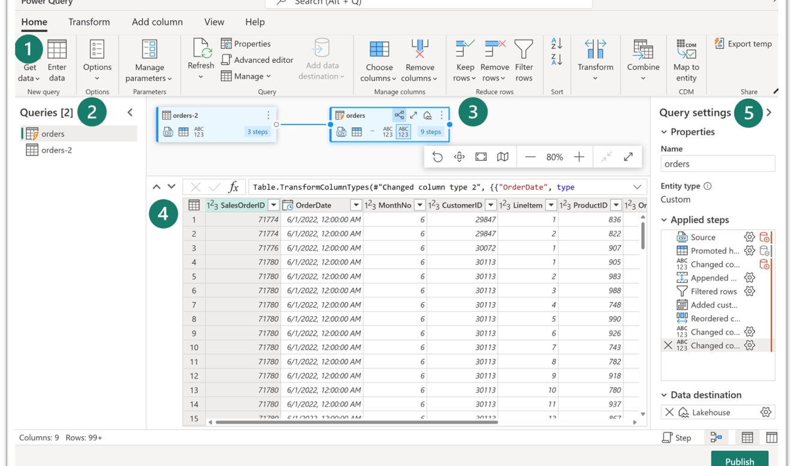
Explore Dataflow Gen2
Power Query ribbon
Queries pane
Diagram view
Data preview
Query settings pane
Notes:
1. Power Query ribbon
Dataflows Gen2 support a wide variety of data source connectors. Common sources include cloud and on-premises relational databases, Excel or flat files, SharePoint, SalesForce, Spark, and Fabric lakehouses. Then there are numerous data transformations possible, such as:
Filter and Sort rows
Pivot and Unpivot
Merge and Append queries
Split and Conditional split
Replace values and Remove duplicates
Add, Rename, Reorder, or Delete columns
Rank and Percentage calculator
Choose Top N and Bottom N
You can also create and manage data source connections, manage parameters, and configure the default data destination in this ribbon.
2. Queries pane
The Queries pane shows you the different data sources - now called queries. These queries are called tables when loaded to your data store. You can duplicate or reference a query if you need multiple copies of the same data, such as creating a star schema and splitting data into separate, smaller tables. You can also disable the load of a query, in case you only need the one-time import.
3. Diagram view
The Diagram View allows you to visually see how the data sources are connected and the different applied transformations. For example, your dataflow connects to a data source, duplicates the query, removes columns from the source query, then unpivots the duplicate query. Each query is represented as a shape with all of the applied transformations and connected by a line for the duplicate query. You can turn this view on or off.
4. Data Preview pane
The Data Preview pane only shows a subset of data to allow you to see which transformations you should make and how they affect the data. You can also interact with the preview pane by dragging and dropping columns to change order or right-clicking on columns to filter or make changes. The data preview shows all of your transformations for the selected query.
5. Query Settings pane
The Query Settings pane includes the Applied Steps. Each transformation you do is tied to a step, some of which are automatically applied when you connect the data source. Depending on the complexity of the transformations, you might have several applied steps for each query. Most steps have a gear icon that allows you to modify the step, otherwise you must delete and repeat the transformation.
Each step also has a contextual menu when you right-click so you can rename, reorder, or delete the steps. You can also view the data source query when connecting to a
While this visual interface is helpful, you can also view the M code through Advanced editor.
In the Query settings pane, you can see a Data Destination option to land your data in one of the following locations in your Fabric environment:
Lakehouse
Warehouse
SQL database
You can also load your dataflow to Azure SQL database, Azure Data Explorer, or Azure Synapse Analytics.
Dataflows Gen2 provide a low-to-no-code solution to ingest, transform, and load data into your Fabric data stores. Power BI developers are familiar and can quickly begin to perform transformations upstream to improve performance for their reports.

Slide 22
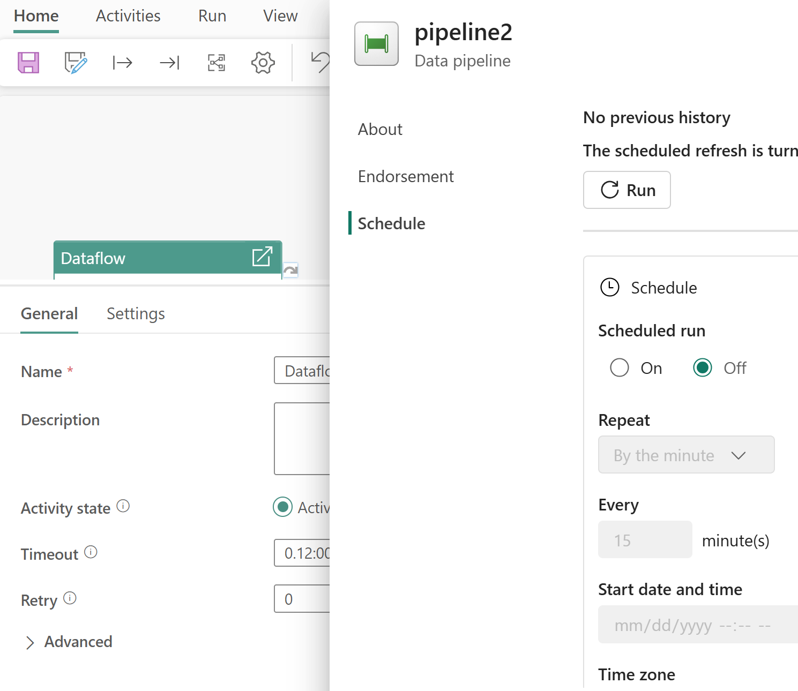
Integrate Dataflow Gen2 and pipelines
Common activities include:
Copy data
Incorporate Dataflow
Add Notebook
Get metadata
Execute a script or stored procedure
Notes:
Dataflows Gen2 provide an excellent option for data transformations in Microsoft Fabric. The combination of dataflows and pipelines is useful when you need to perform additional operations on the transformed data.
Data pipelines are a common concept in data engineering and offer a wide variety of activities to orchestrate. Some common activities include:
Copy data
Incorporate Dataflow
Add Notebook
Get metadata
Execute a script or stored procedure
Pipelines provide a visual way to complete activities in a specific order. You can use a dataflow for data ingestion, transformation, and landing into a Fabric data store. Then incorporate the dataflow into a pipeline to orchestrate extra activities, like execute scripts or stored procedures after the dataflow has completed.
Pipelines can also be scheduled or activated by a trigger to run your dataflow. By using a pipeline to run your dataflow, you can have the data refreshed when you need it instead of having to manually run the dataflow. When you're dealing with enterprise or frequently changing data, automation allows you to focus on other responsibilities.

Slide 23
Exercise
Create and use a Dataflow Gen2 in Microsoft Fabric
30 minutes
Notes:
https://aka.ms/mslearn-fabric-dataflow The estimated time to complete this exercise is 30 minutes.

Slide 24
Knowledge check
1
What is a Dataflow Gen2?
A hybrid database that supports ACID transactions
A way to export data to Power BI Desktop
A way to import and transform data with Power Query Online
2
Which Fabric experience lets you create a Dataflow Gen2?
Real-time analytics
Data warehouse
Data Factory
3
How do Dataflow Gen2 in Microsoft Fabric facilitate collaboration?
By providing a shared and collaborative environment for data transformation and integration
By enabling real-time data streaming and event processing
By integrating with popular business intelligence tools for data visualization
Notes:
Allow students a few minutes to think about the questions, and then use the animated slide to reveal the correct answers.

Slide 25
Recap
In this section, we covered:
Dataflow Gen2 capabilities in Microsoft Fabric.
Dataflow Gen2 solutions to ingest and transform data.
Using a Dataflow Gen2 in a pipeline.

Slide 26
Further reading
Ingest Data with Dataflow Gen2 in Microsoft Fabric
https://aka.ms/fabric-dataflow
Notes:
Encourage students to review the online material on Microsoft Learn on which this presentation is based.
More info on Dataflow Gen2 behind the scenes: https://blog.fabric.microsoft.com/blog/data-factory-spotlight-dataflows-gen2#

Slide 27
Orchestrate processes and data movement with Microsoft Fabric
Notes:
https://aka.ms/fabric-pipeline Before delivering this presentation, review the associated module on Microsoft Learn.
The estimated time to present these slides is 30 minutes.

Slide 28
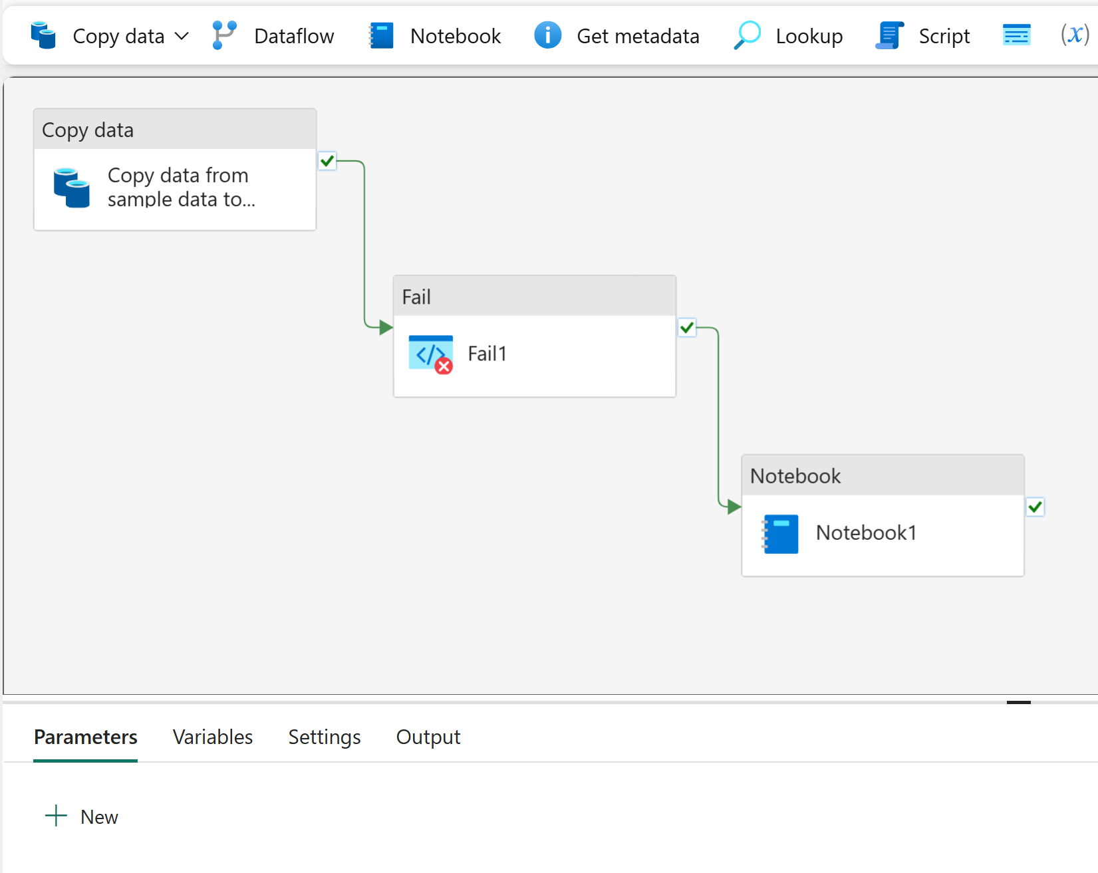
Pipelines in Microsoft Fabric
Pipeline concepts:
Activities
Data transformation
Control flow
Parameters
Pipeline runs
Notes:
There are two primary high-level features Data Factory implements: dataflows and pipelines.
Data Pipelines enable you to leverage rich out-of-the-box data orchestration capabilities to compose flexible data workflows that meet your enterprise needs. You can learn more about their capabilities in the Data Factory Spotlight: data pipelines blog post.
Dataflow Gen2 enable you to leverage a low-code interface and 300+ data and AI-based transformations, letting you transform data easier and with more flexibility than any other tool.
Pipelines in Microsoft Fabric encapsulate a sequence of activities that perform data movement and processing tasks. You can use a pipeline to define data transfer and transformation activities, and orchestrate these activities through control flow activities that manage branching, looping, and other typical processing logic. The graphical pipeline canvas in the Fabric user interface enables you to build complex pipelines with minimal or no coding required.
Click to reveal Core pipeline concepts
Activities
Activities are the executable tasks in a pipeline. You can define a flow of activities by connecting them in a sequence. The outcome of a particular activity (success, failure, or completion) can be used to direct the flow to the next activity in the sequence.
There are two broad categories of activity in a pipeline.
Data transformation activities - activities that encapsulate data transfer operations, including simple Copy Data activities that extract data from a source and load it to a destination, and more complex Data Flow activities that encapsulate dataflows Gen2 that apply transformations to the data as it is transferred.
Control flow activities - activities that you can use to implement loops, conditional branching, or manage variable and parameter values.
Parameters
Pipeline runs

Slide 29
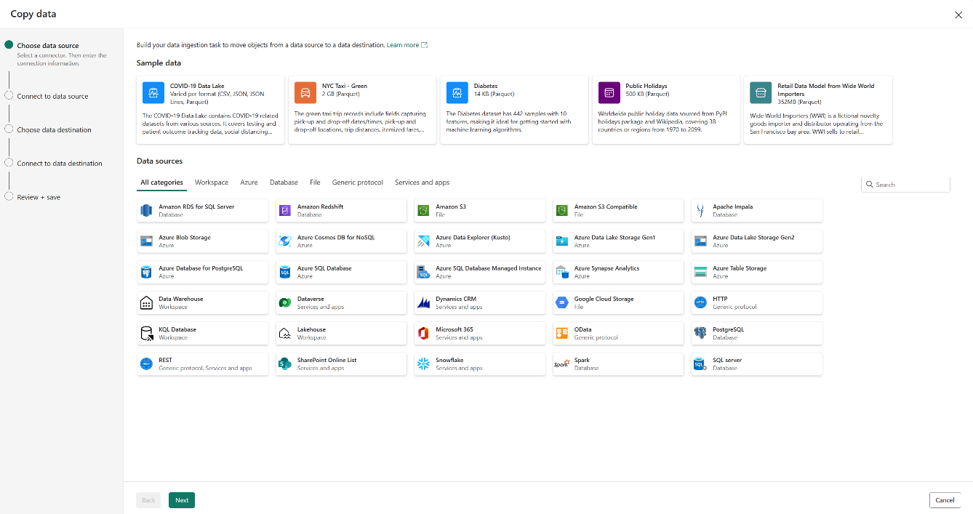
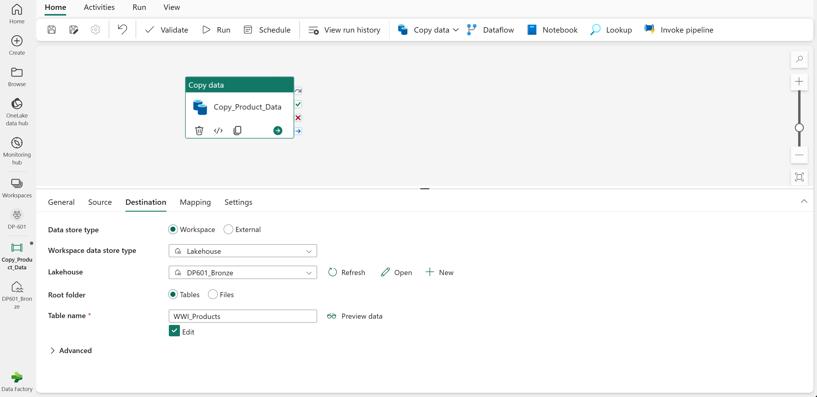
Common Activities – copy data
1. Use the copy data tool.
2. Edit the settings below the pipeline canvas.
Notes:
This is a build slide.
The Copy Data activity is one of the most common uses of a data pipeline. Many pipelines consist of a single Copy Data activity that is used to ingest data from an external source into a lakehouse file or table.
The Copy Data tool - When you add a Copy Data activity to a pipeline, a graphical tool takes you through the steps required to configure the data source and destination for the copy operation. A wide range of source connections is supported, making it possible to ingest data from most common sources.
Click
Copy Data activity settings - After you've added a Copy Data activity to a pipeline, you can select it in the pipeline canvas and edit its settings in the pane underneath.
Use the Copy Data activity when you need to copy data directly between a supported source and destination without applying any transformations, or when you want to import the raw data and apply transformations in later pipeline activities.
If you need to apply transformations to the data as it is ingested, or merge data from multiple sources, consider using a Data Flow activity to run a Dataflow Gen2. You can use the Power Query user interface to define a Dataflow Gen2 that includes multiple transformation steps, and include it in a pipeline.

Slide 30
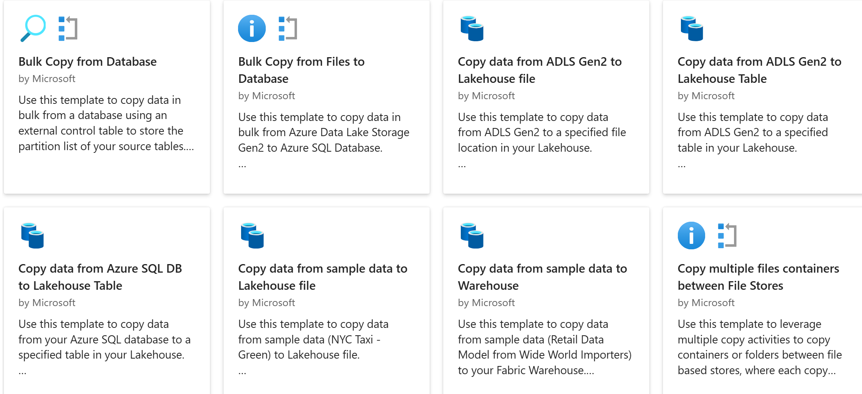
Use templates for common activities
Notes:
There are many common pipeline scenarios for which Microsoft Fabric includes predefined pipeline templates that you can use and customize as required.
To create a pipeline based on a template, select the Choose a task to start tile in a new pipeline.

Slide 31
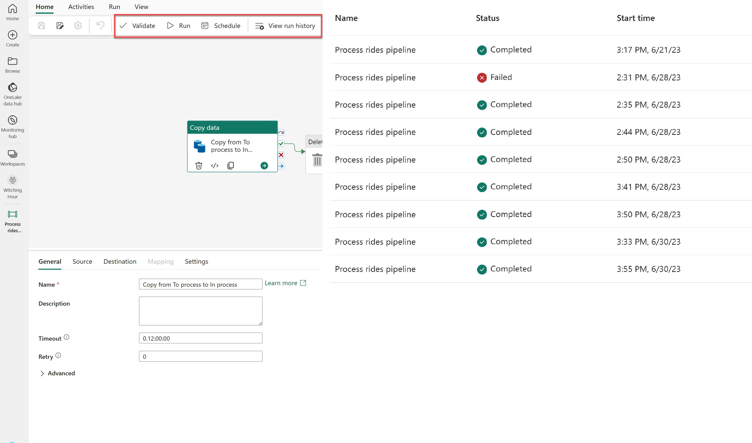
Run and monitor pipelines
Validate
Run
Schedule
View run history
Notes:
When you have completed a pipeline, you can use the Validate option to check that is configuration is valid, and then either run it interactively or specify a schedule.
The Run button will manually trigger a data pipeline run.
When you schedule a data pipeline run, you can choose the frequency that your pipeline runs. Select Schedule, found in the top banner of the Home tab, to view your options. By default, your data pipeline won't be set on a schedule.
When you view a pipeline run history from the workspace page, you can select the Run start value to see the details of an individual run; including the option to view the individual execution time for each activity as a Gantt chart.

Slide 32
Exercise
Ingest data with a pipeline
60 minutes
Notes:
https://aka.ms/mslearn-fabric-pipeline
The estimated time to complete this exercise is 60 minutes.

Slide 33
Knowledge check
1
What is a data pipeline?
A special folder in OneLake storage where data can be exported from a lakehouse.
A sequence of activities to orchestrate a data ingestion or transformation process.
A saved Power Query.
2
You want to use a pipeline to copy data to a folder with a specified name for each run. What should you do?
Create multiple pipelines – One for each folder name.
Use a Dataflow Gen2.
Add a parameter to the pipeline and use it to specify the folder name for each run.
3
You have previously run a pipeline containing multiple activities. What's the best way to check how long each individual activity took to complete?
Rerun the pipeline and observe the output, timing each activity.
View the run details in the run history.
View the refreshed value for your lakehouse’s default semantic model.
Notes:
Allow students a few minutes to think about the questions, and then use the animated slide to reveal the correct answers.

Slide 34
Recap
In this section, we covered:
Pipeline capabilities in Microsoft Fabric.
Add Copy Data activity in a pipeline.
How to create pipelines based on predefined templates.
How to run and monitor pipelines.

Slide 35
Further Reading
Use Data Factory pipelines in Microsoft Fabric
https://aka.ms/fabric-pipeline
Notes:
Encourage students to review the online material on Microsoft Learn on which this presentation is based.

Slide 36
Use Apache Spark in Microsoft Fabric
Notes:
aka.ms/fabric-spark Before delivering this presentation, review the associated module on Microsoft Learn.
The estimated time to present these slides is 30 minutes.

Slide 37
What is Apache Spark?
Apache Spark is a core technology for large-scale data analytics.
Microsoft Fabric provides support for Spark clusters, enabling you to analyze and process data in a lakehouse at scale.
Notes:
Apache Spark is an open-source framework for large-scale data processing and analytics. Apache Spark is integrated into Microsoft Fabric to provide a big data platform for analytics.
Fabric Spark clusters provide a powerful, in-memory distributed framework for at-scale data processing. In Microsoft Fabric, Spark can be used together with other analytics services such as lakehouses, notebooks, and data pipelines.
In this section we explore how to use Spark with notebooks to ingest, process, and analyze data in a Fabric lakehouse.

Slide 38
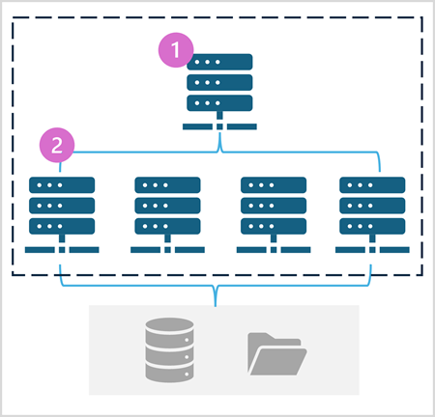
How to use Apache Spark
Distributed data processing framework through Spark pools.
Use notebooks to ingest, transform, load, analyze, and visualize data.
Notebooks in Fabric support many programming languages, including PySpark and Spark SQL.
Notes:
Apache Spark is a distributed data processing framework that enables large-scale data analytics by coordinating work across multiple processing nodes in a cluster, known in Microsoft Fabric as a Spark pool. Put more simply, Spark uses a "divide and conquer" approach to processing large volumes of data quickly by distributing the work across multiple computers. The process of distributing tasks and collating results is handled for you by Spark.
Spark can run code written in a wide range of languages, including Java, Scala (a Java-based scripting language), Spark R, Spark SQL, and PySpark (a Spark-specific variant of Python). In practice, most data engineering and analytics workloads are accomplished using a combination of PySpark and Spark SQL.
A Spark pool consists of compute nodes that distribute data processing tasks. As shown in the diagram, a Spark pool contains two kinds of node:
A head node in a Spark pool coordinates distributed processes through a driver program.
The pool includes multiple worker nodes on which executor processes perform the actual data processing tasks.
The Spark pool uses this distributed compute architecture to access and process data in a compatible data store - such as a data lakehouse based in OneLake.
Spark pools in Microsoft Fabric
Microsoft Fabric provides a starter pool in each workspace, enabling Spark jobs to be started and run quickly with minimal setup and configuration. You can configure the starter pool to optimize the nodes it contains in accordance with your specific workload needs or cost constraints.
Note: Administrators can manage Spark settings at a Fabric capacity level, enabling them to restrict and override Spark settings in workspaces within an organization.

Slide 39
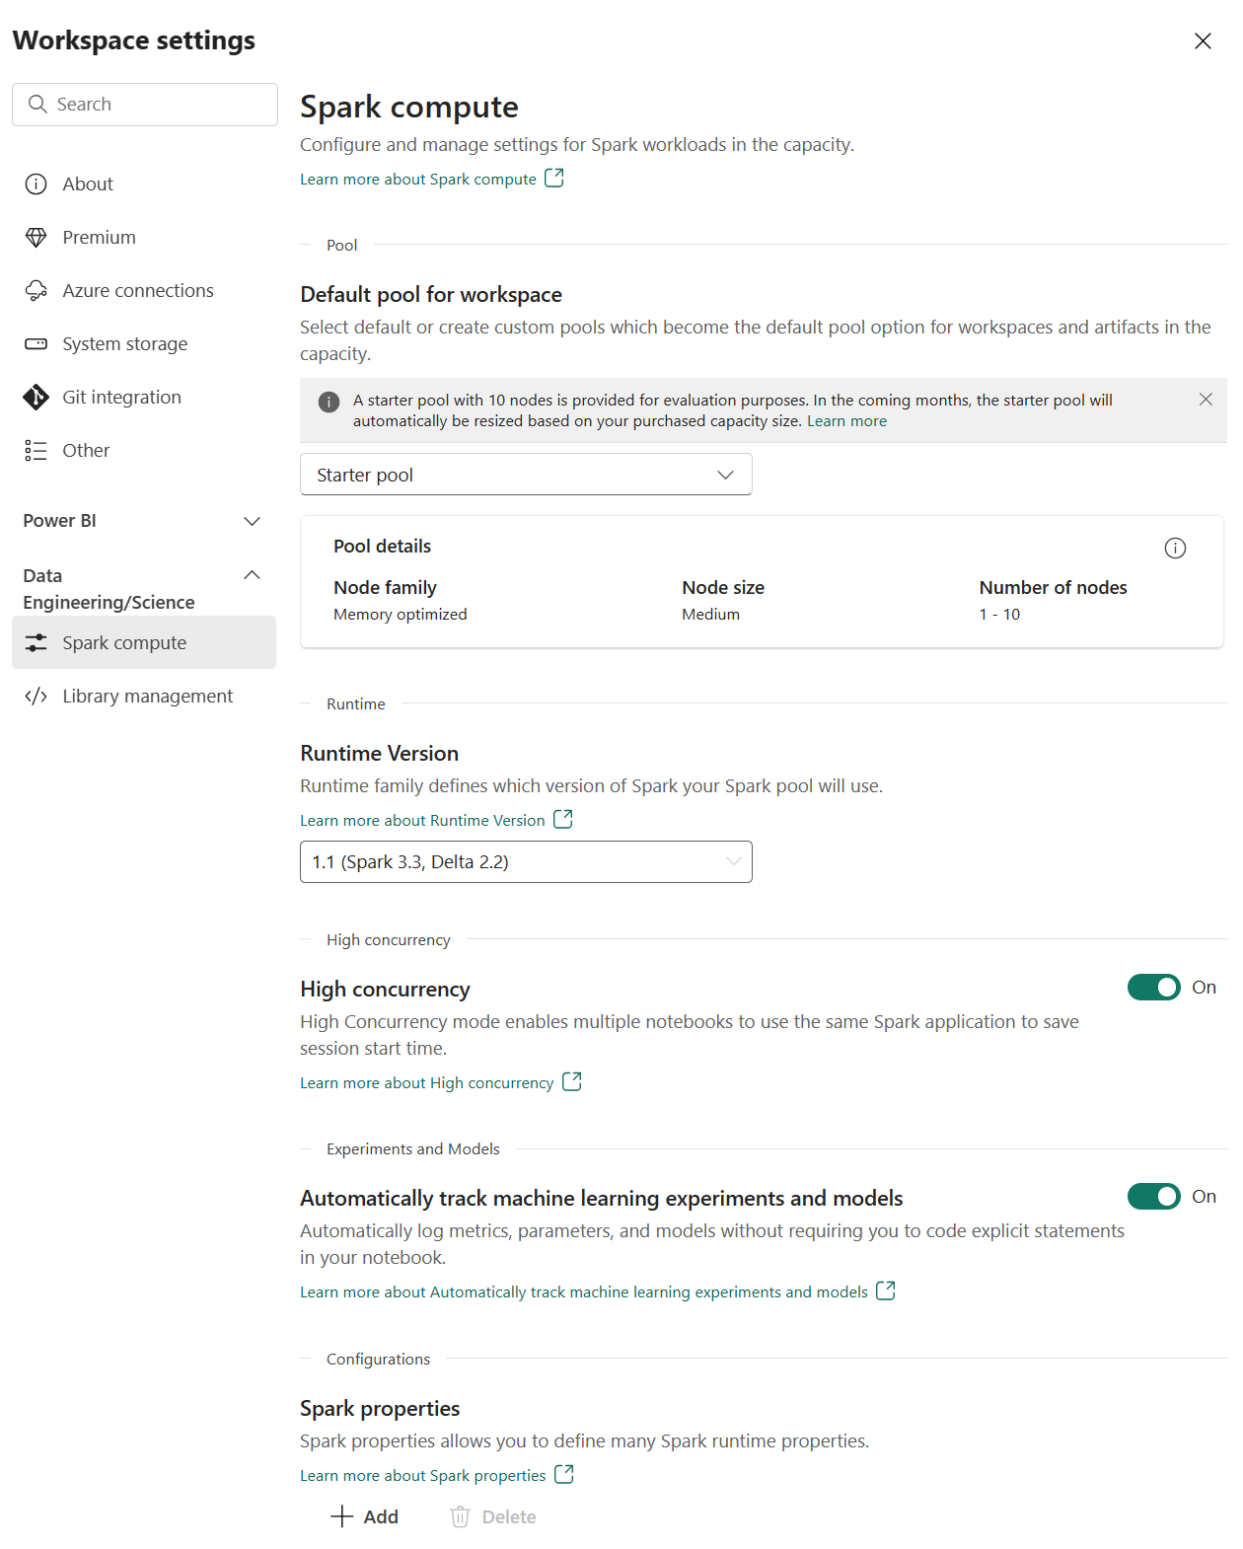
Prepare to use Apache Spark
Each workspace is assigned a Spark cluster.
Workspace admins can manage settings for the Spark cluster in the Workspace settings.
Specific configuration settings include:
Node family
Runtime version
Spark properties
Notes:
Apache Spark is often used in conjunction with a data lake architecture to process and analyze large volumes of data stored in the data lake. Use Spark in Fabric to continue transforming data or to build a machine learning model.
Apache Spark is distributed data processing framework that enables large-scale data analytics by coordinating work across multiple processing nodes in a cluster. Put more simply, Spark uses a "divide and conquer" approach to processing large volumes of data quickly by distributing the work across multiple computers. The process of distributing tasks and collating results is handled for you by Spark.
You submit a data processing job in the form of some code that initiates a driver program, which uses a cluster management object called the SparkContext to manage the distribution of processing in the Spark cluster. In most cases, these details are abstracted - you just need to write the code required to perform the data operations you need.
Spark can run code written in a wide range of languages, including Java, Scala (a Java-based scripting language), Spark R, Spark SQL, and PySpark (a Spark-specific variant of Python). Most data engineering and analytics workloads are accomplished using a combination of PySpark and Spark SQL.
Settings In Microsoft Fabric, each workspace is assigned a Spark cluster. An administrator can manage settings for the Spark cluster in the Data Engineering/Science section of the workspace settings.
Libraries The Spark open source ecosystem includes a wide selection of code libraries for common (and sometimes very specialized) tasks. Since a great deal of Spark processing is performed using PySpark, the huge range of Python libraries ensures that whatever the task you need to perform, there's probably a library to help.

Slide 40
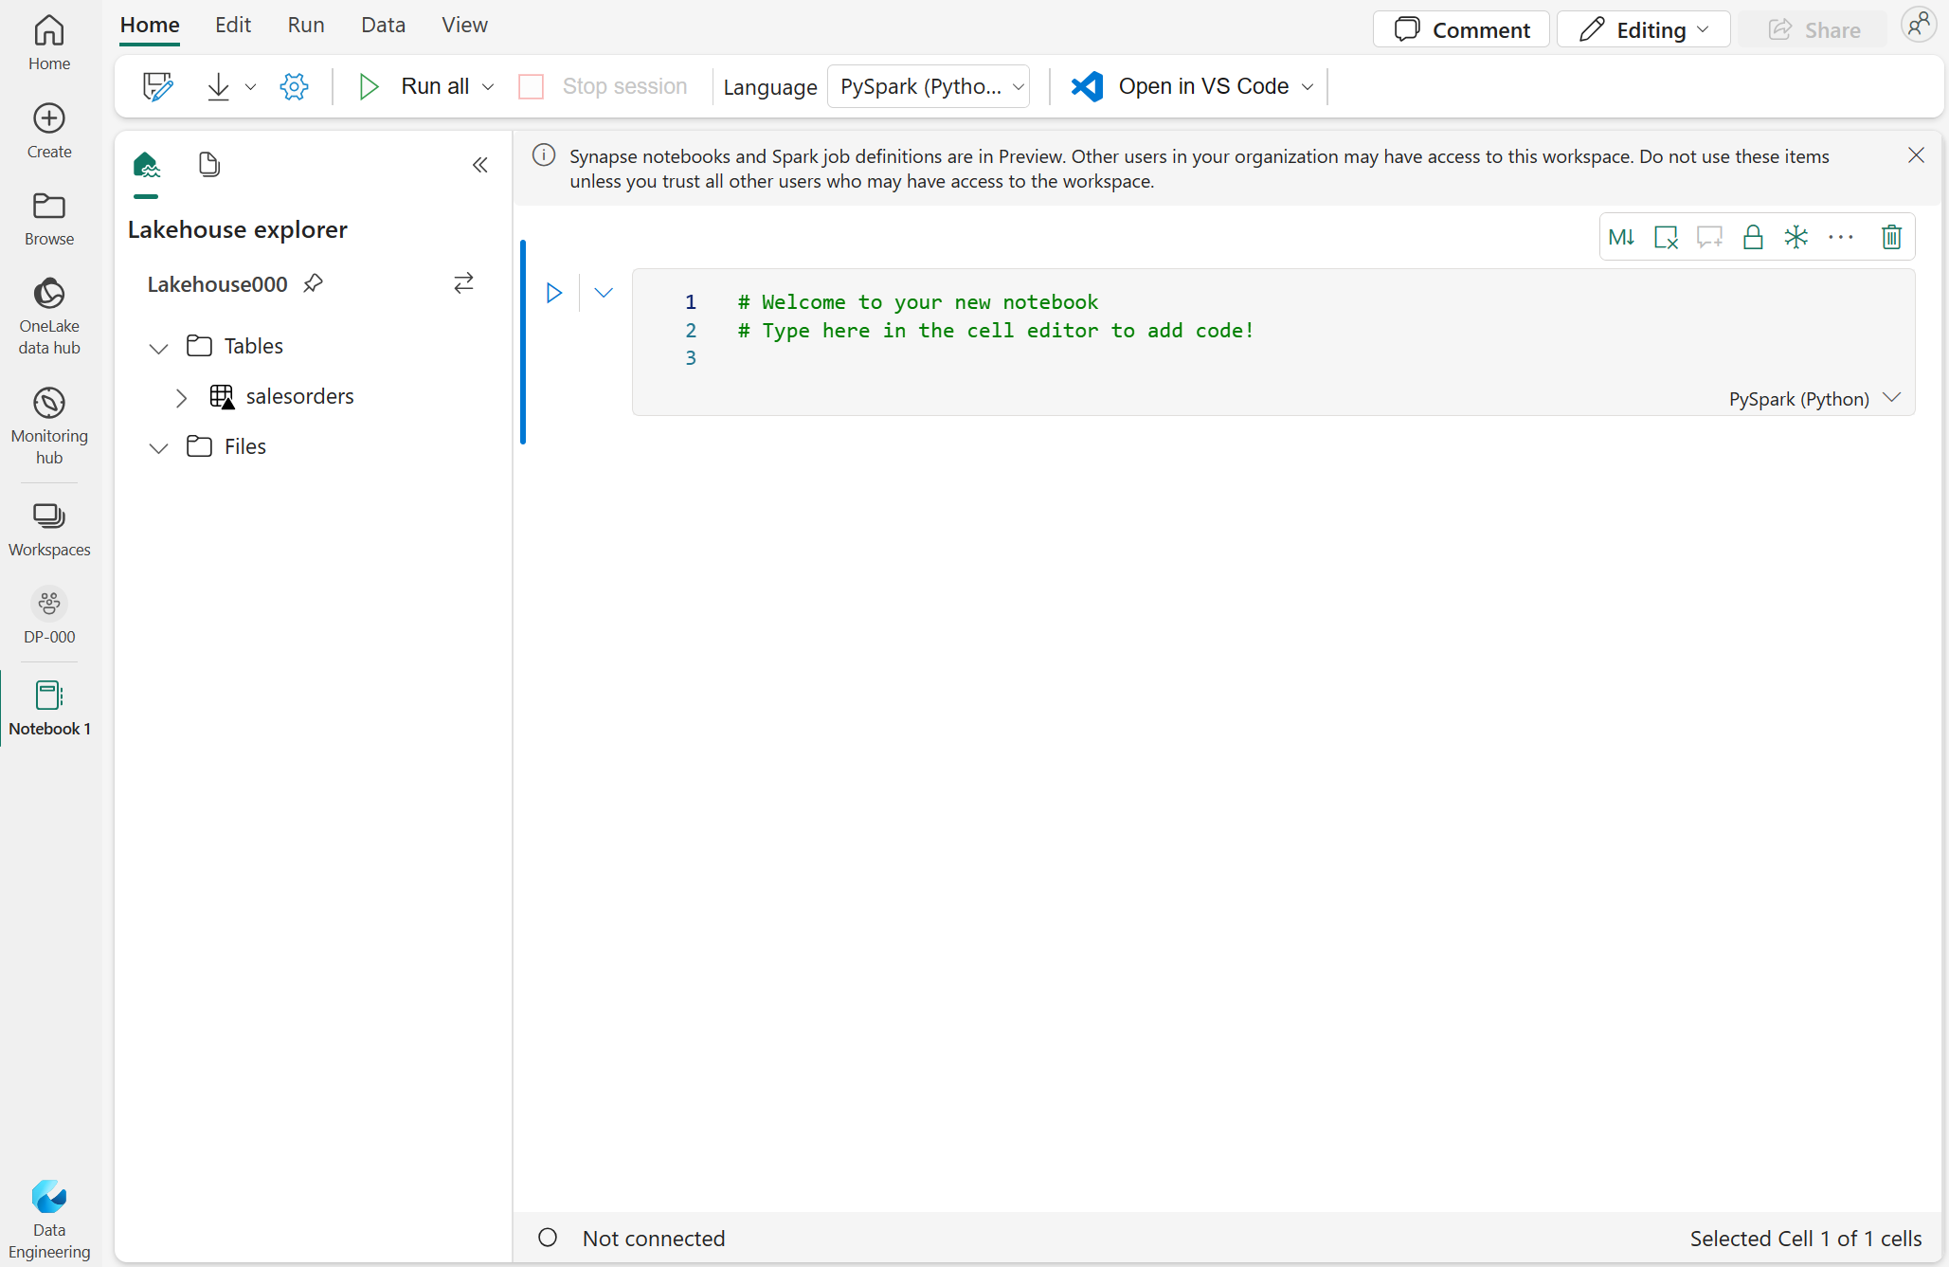
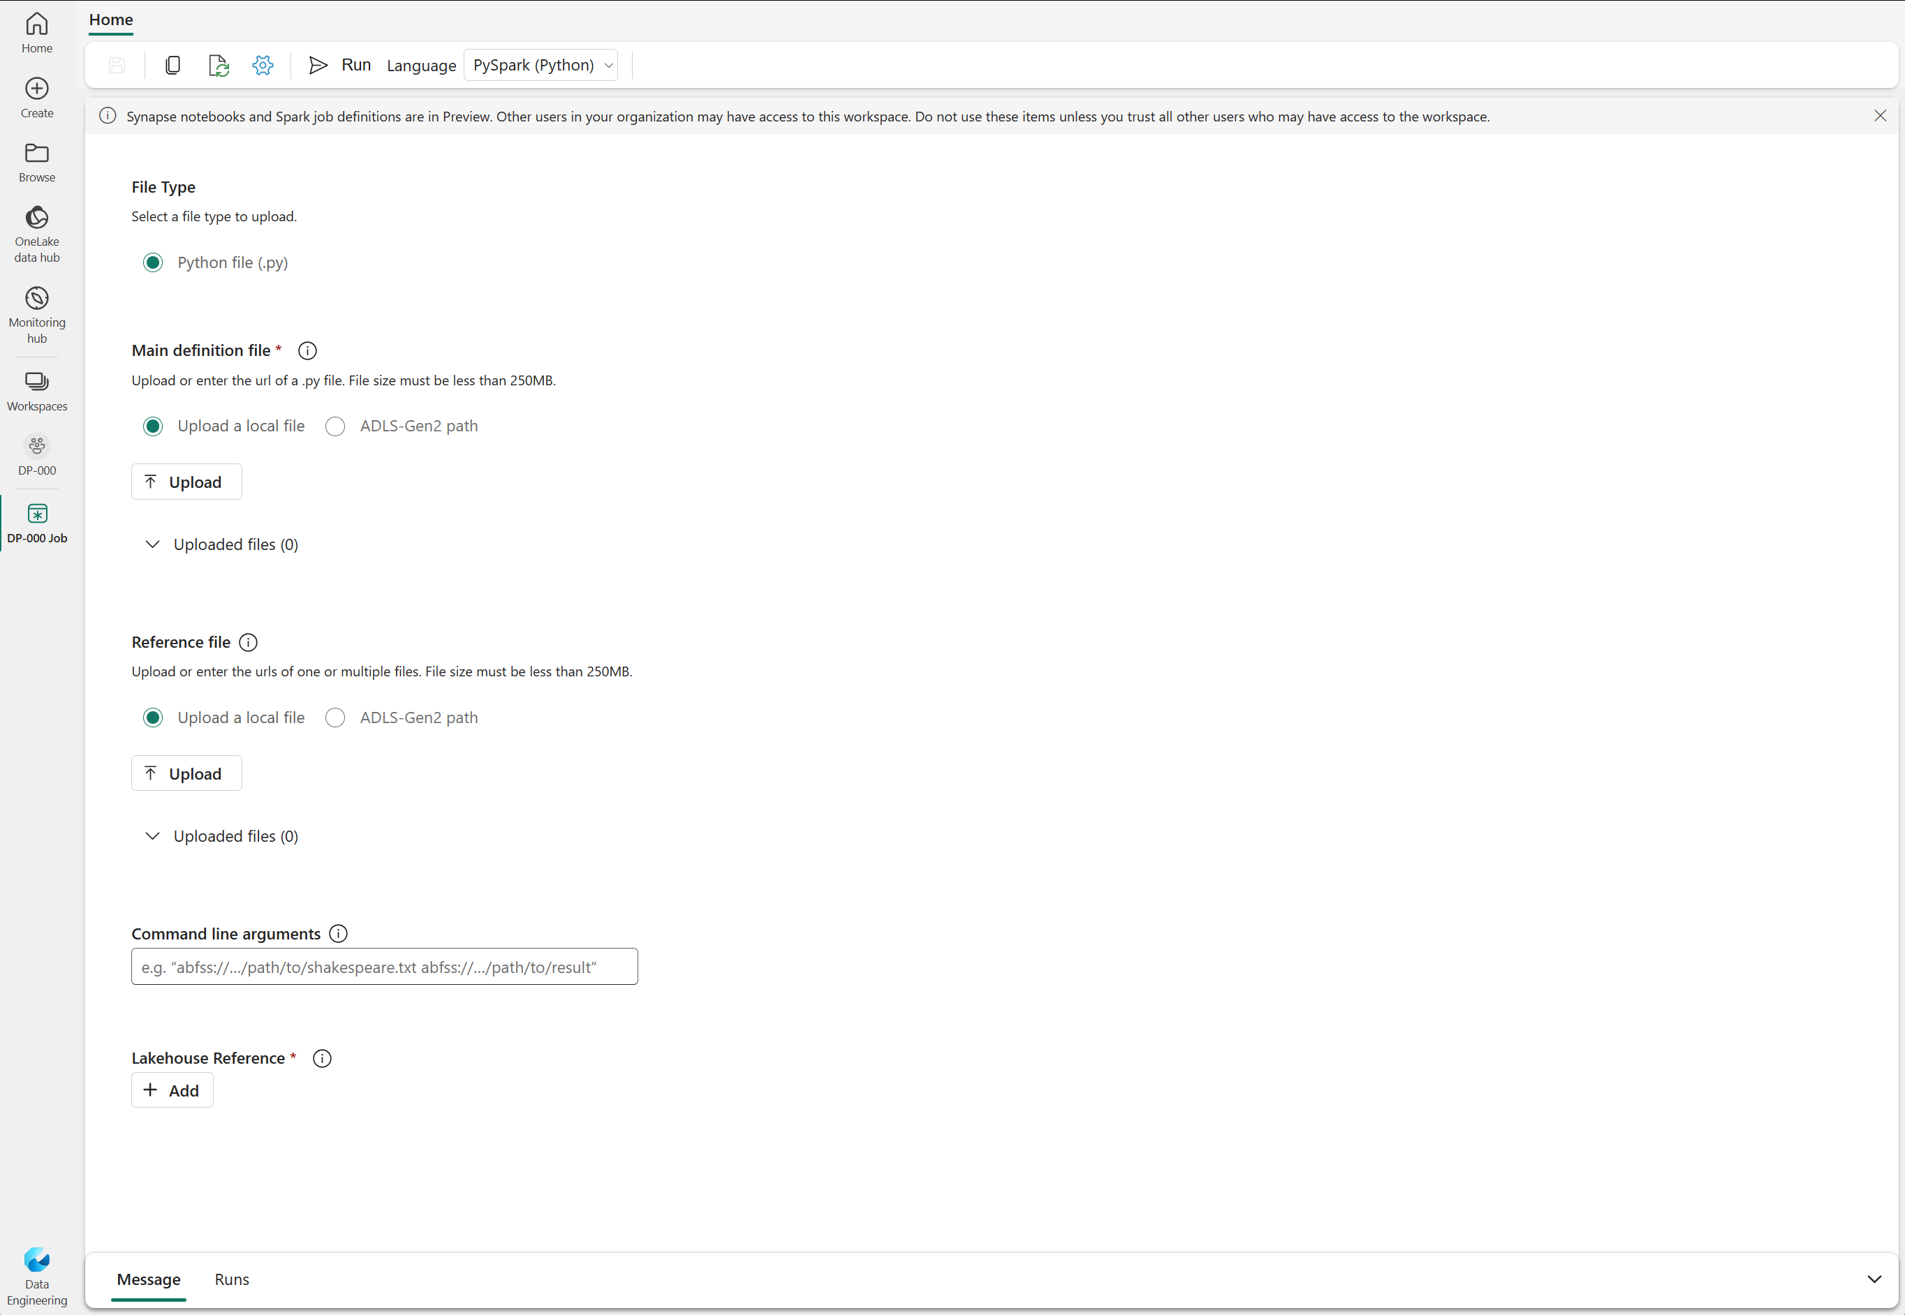
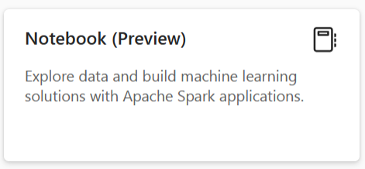
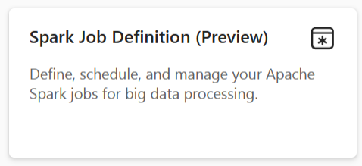
Run Spark in Fabric
To edit and run Spark code in Fabric, use notebooks or create a Spark Job Definition.
Non-interactive script run in Spark at a scheduled time
Interactive environment for coding and collaborative notes
Notes:
This is a build slide.
To edit and run Spark code in Microsoft Fabric, you can use notebooks, or you can define a Spark job. Click 1. Run Spark in a notebook
When you want to use Spark to explore and analyze data interactively, use a notebook. Notebooks enable you to combine text, images, and code written in multiple languages to create an interactive artifact that you can share with others and collaborate. Notebooks consist of one or more cells, each of which can contain markdown-formatted content or executable code. You can run the code interactively in the notebook and see the results immediately.
Click
2. Define a Spark job
If you want to use Spark to ingest and transform data as part of an automated process, you can define a Spark job to run a script on-demand or based on a schedule. To configure a Spark job, create a Spark Job Definition in your workspace and specify the script it should run. You can also specify a reference file (for example, a Python code file containing definitions of functions that are used in your script) and a reference to a specific lakehouse containing data that the script processes.

Slide 41
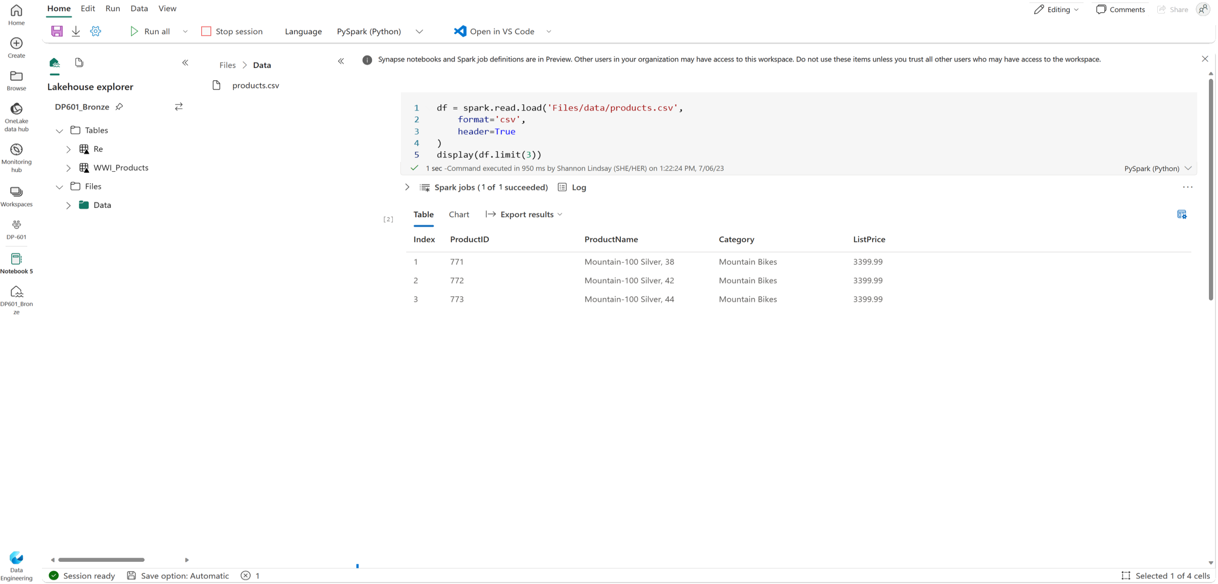
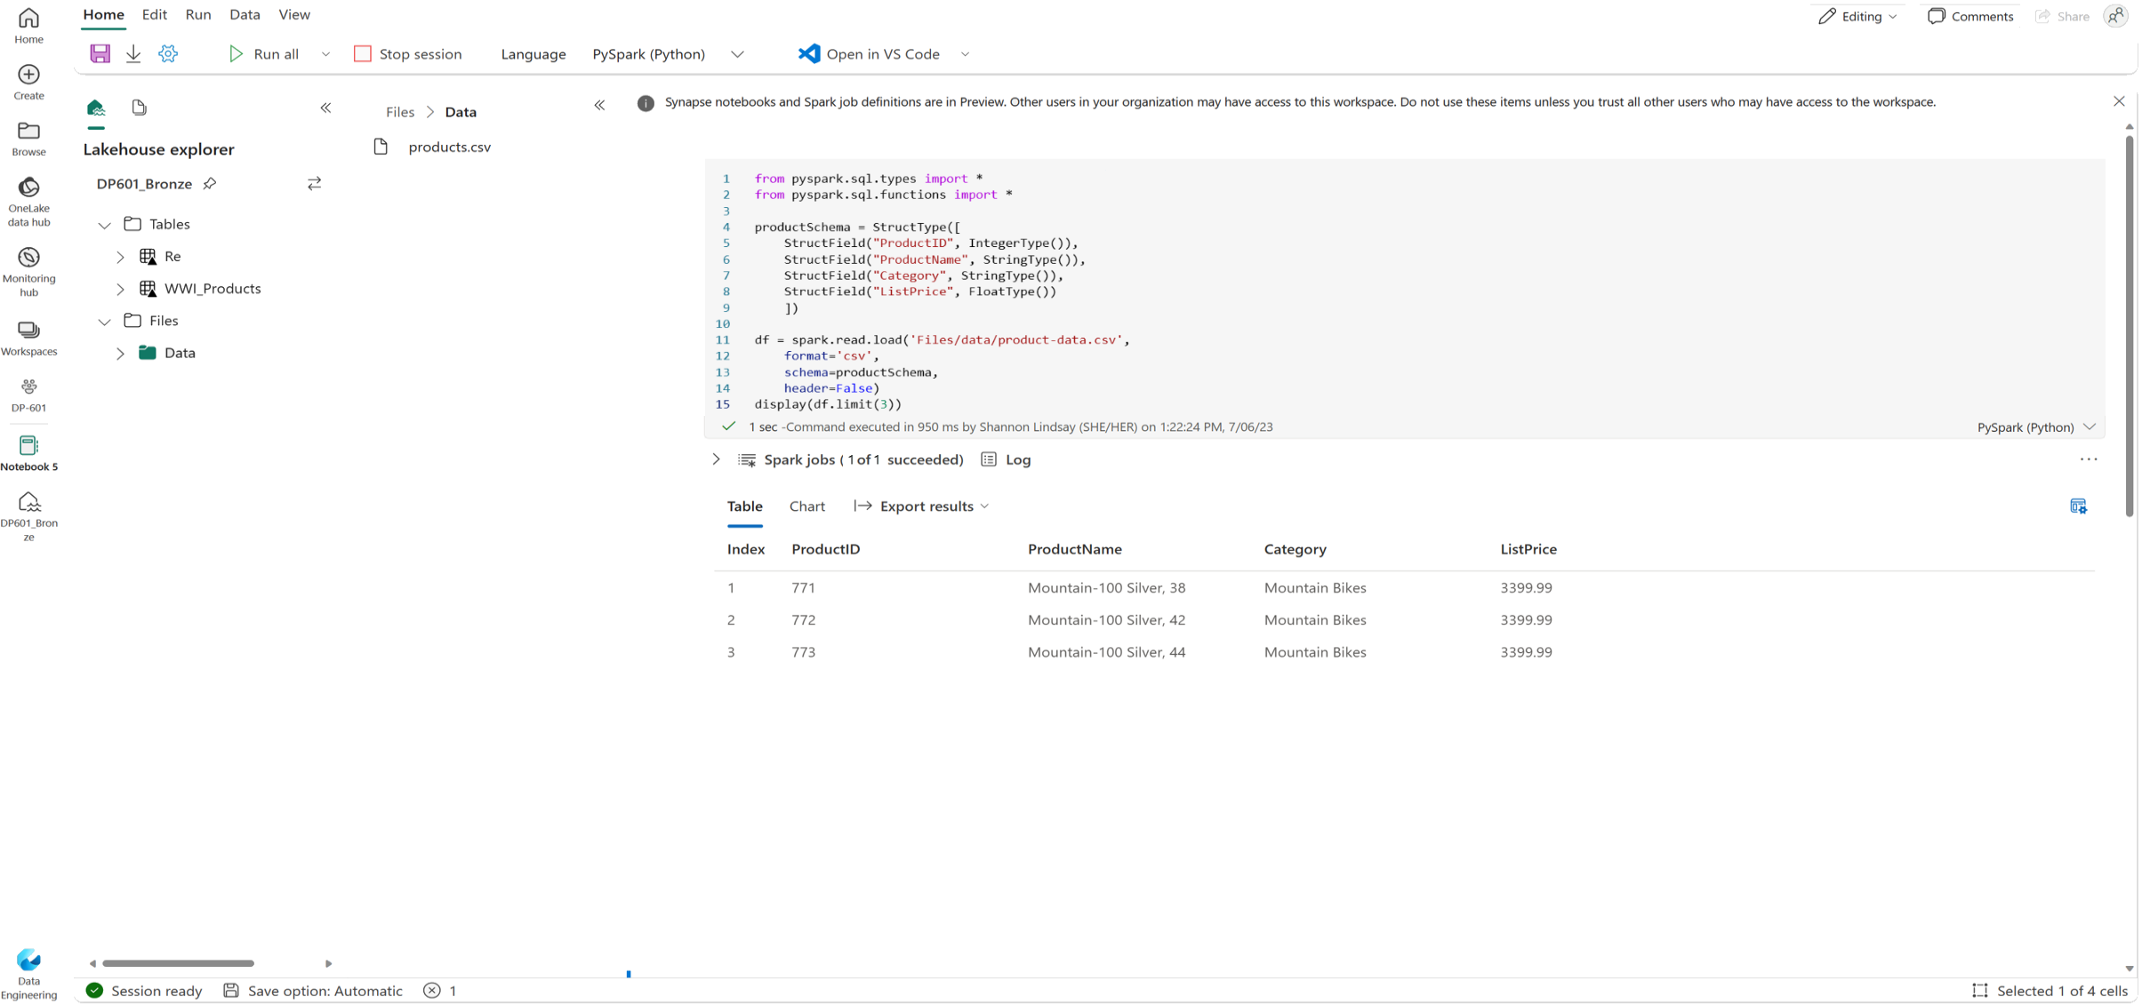
Load data in a Spark Dataframe
Schema can be either inferred or specified
Infer a schema
Specify a schema
Notes:
This is a build slide.
Working with data in a dataframe (within a notebook) combines the interactivity of data exploration, expressive data manipulation capabilities, visualizations, collaborative analysis, iterative development, and documentation in a single environment.
Natively, Spark uses a data structure called a resilient distributed dataset (RDD); but while you can write code that works directly with RDDs, the most commonly used data structure for working with structured data in Spark is the dataframe, which is provided as part of the Spark SQL library. Dataframes in Spark are similar to those in the ubiquitous Pandas Python library, but optimized to work in Spark's distributed processing environment.
Inferring a schema
Suppose you have a comma-delimited text file named products.csv in the Files/data folder in your lakehouse. In a Spark notebook, you could use the following PySpark code to load the file data into a dataframe and display the first 10 rows.
The dataframe includes standard functionality for transforming data.
Click to see:
Specifying an explicit schema
In the previous example, the first row of the CSV file contained the column names, and Spark was able to infer the data type of each column from the data it contains. You can also specify an explicit schema for the data, which is useful when the column names aren't included in the data file.

Slide 42
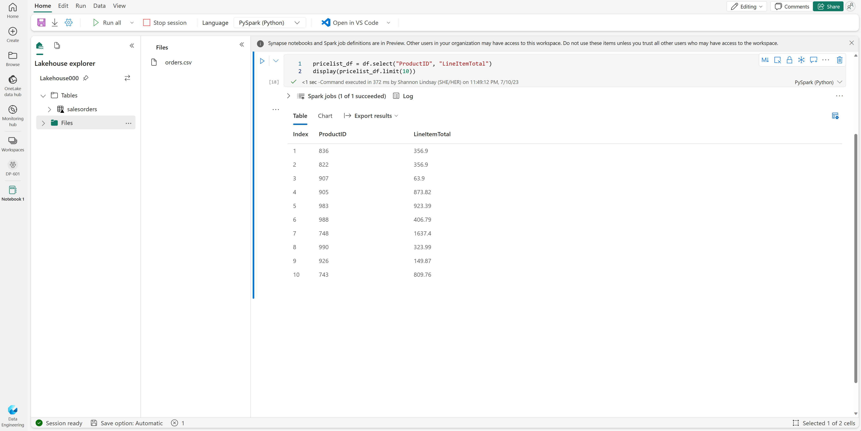
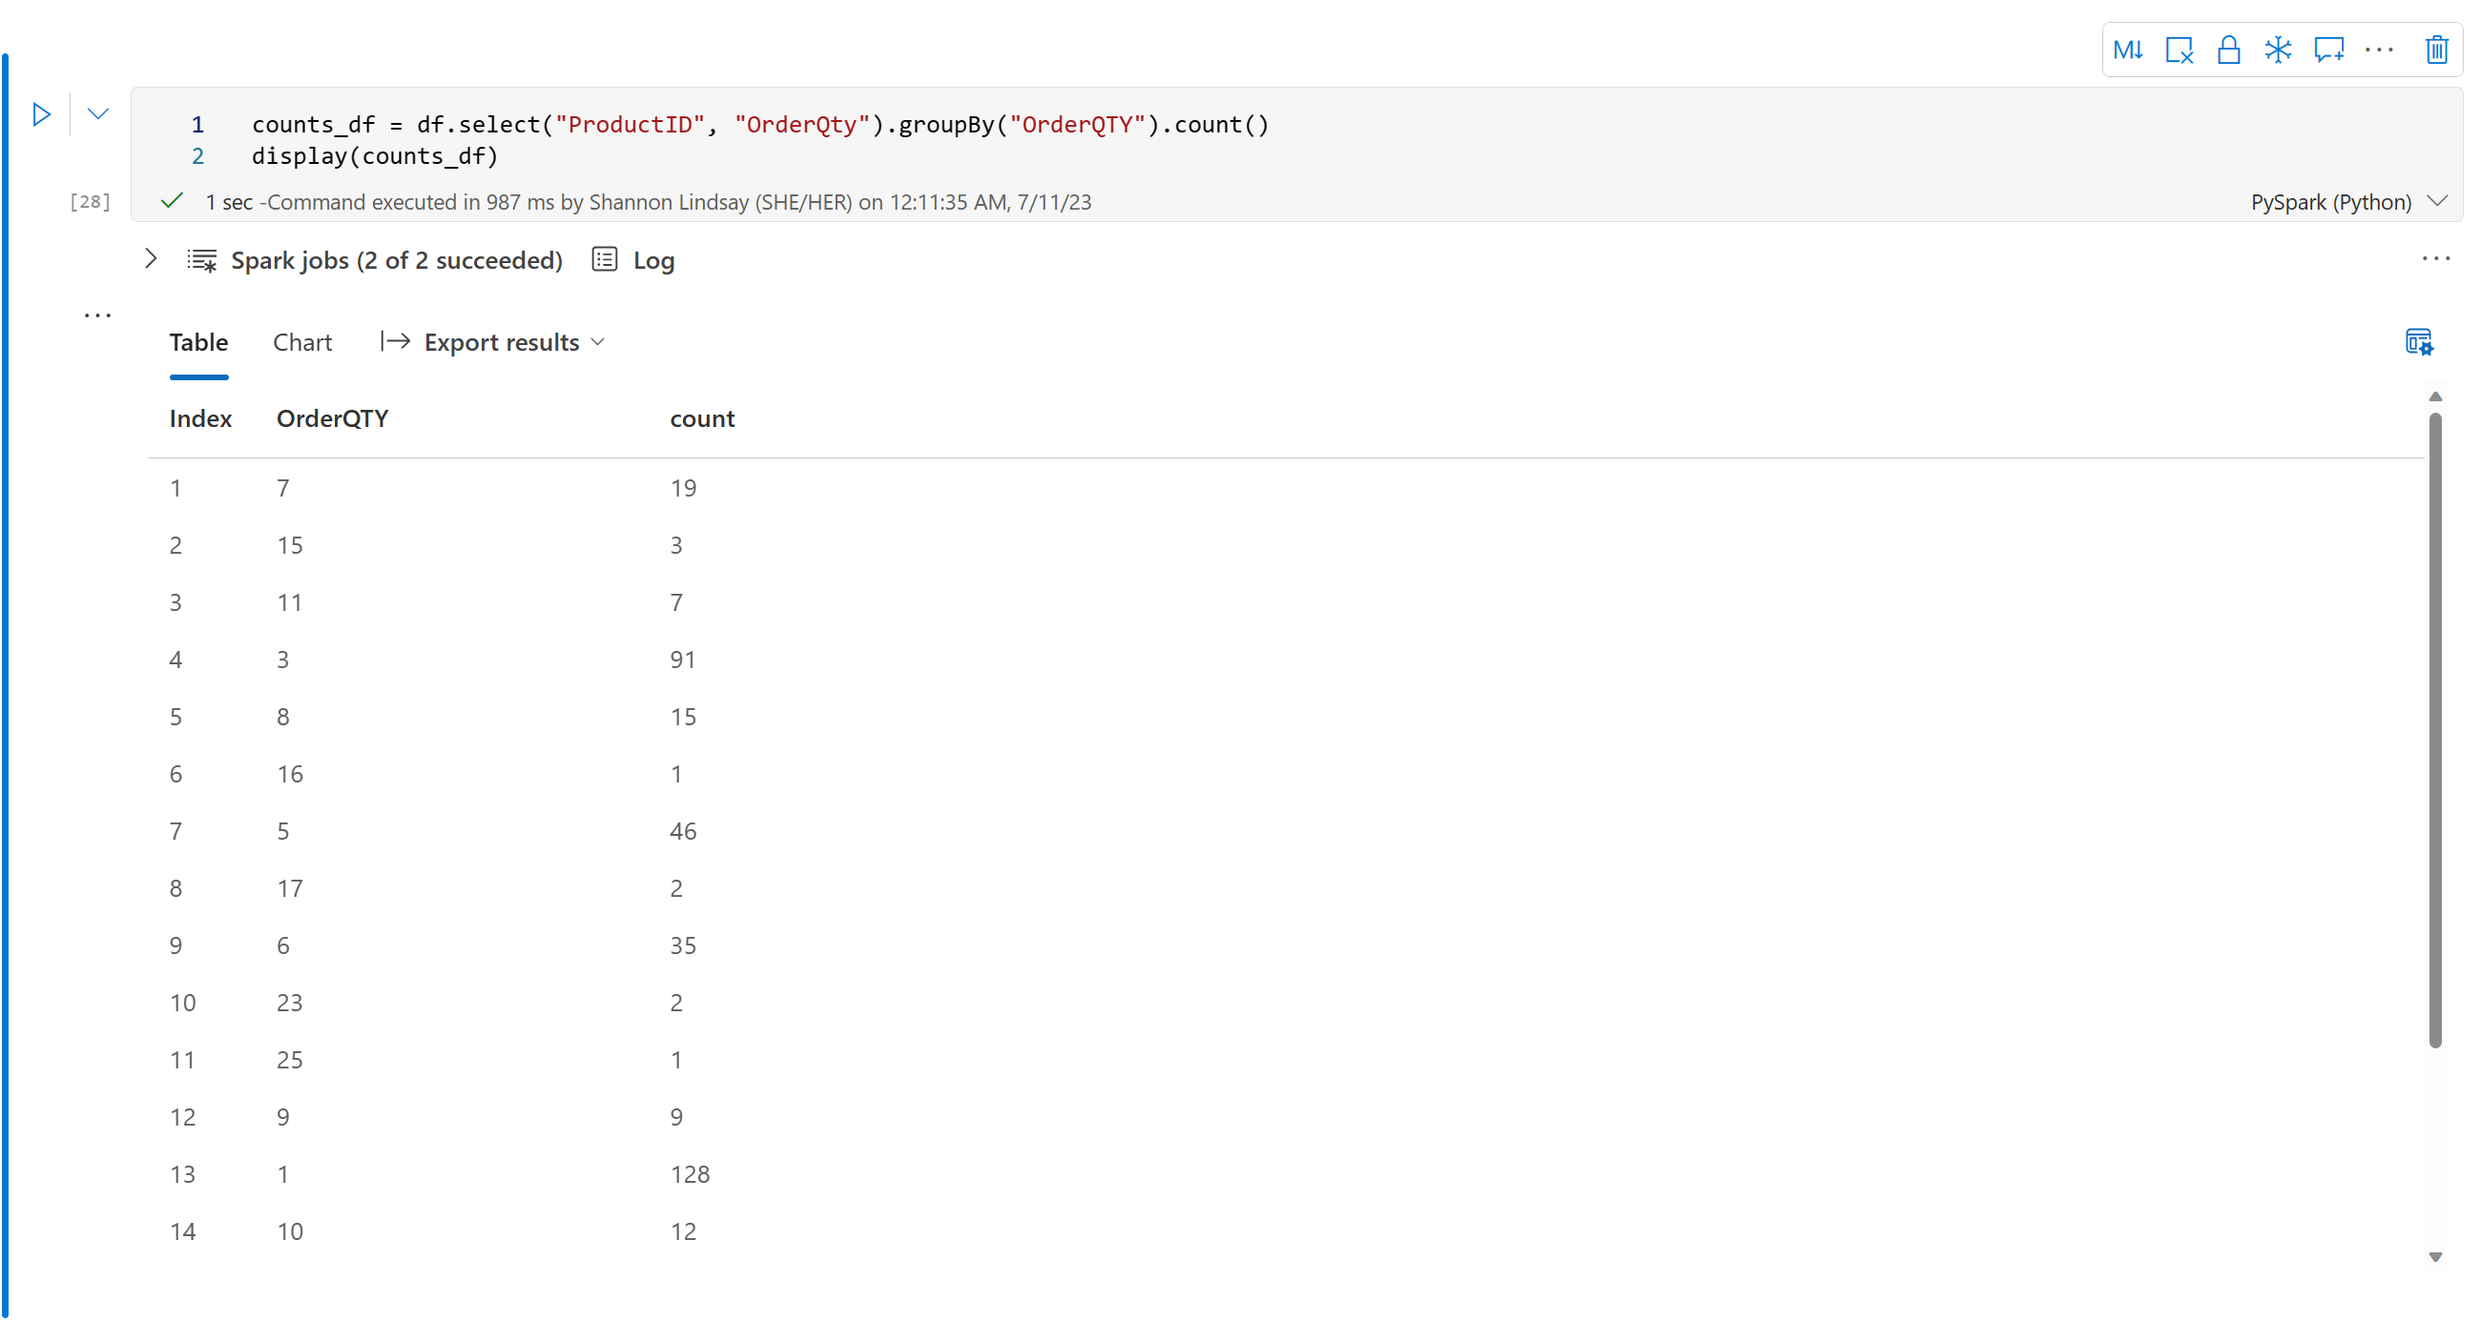
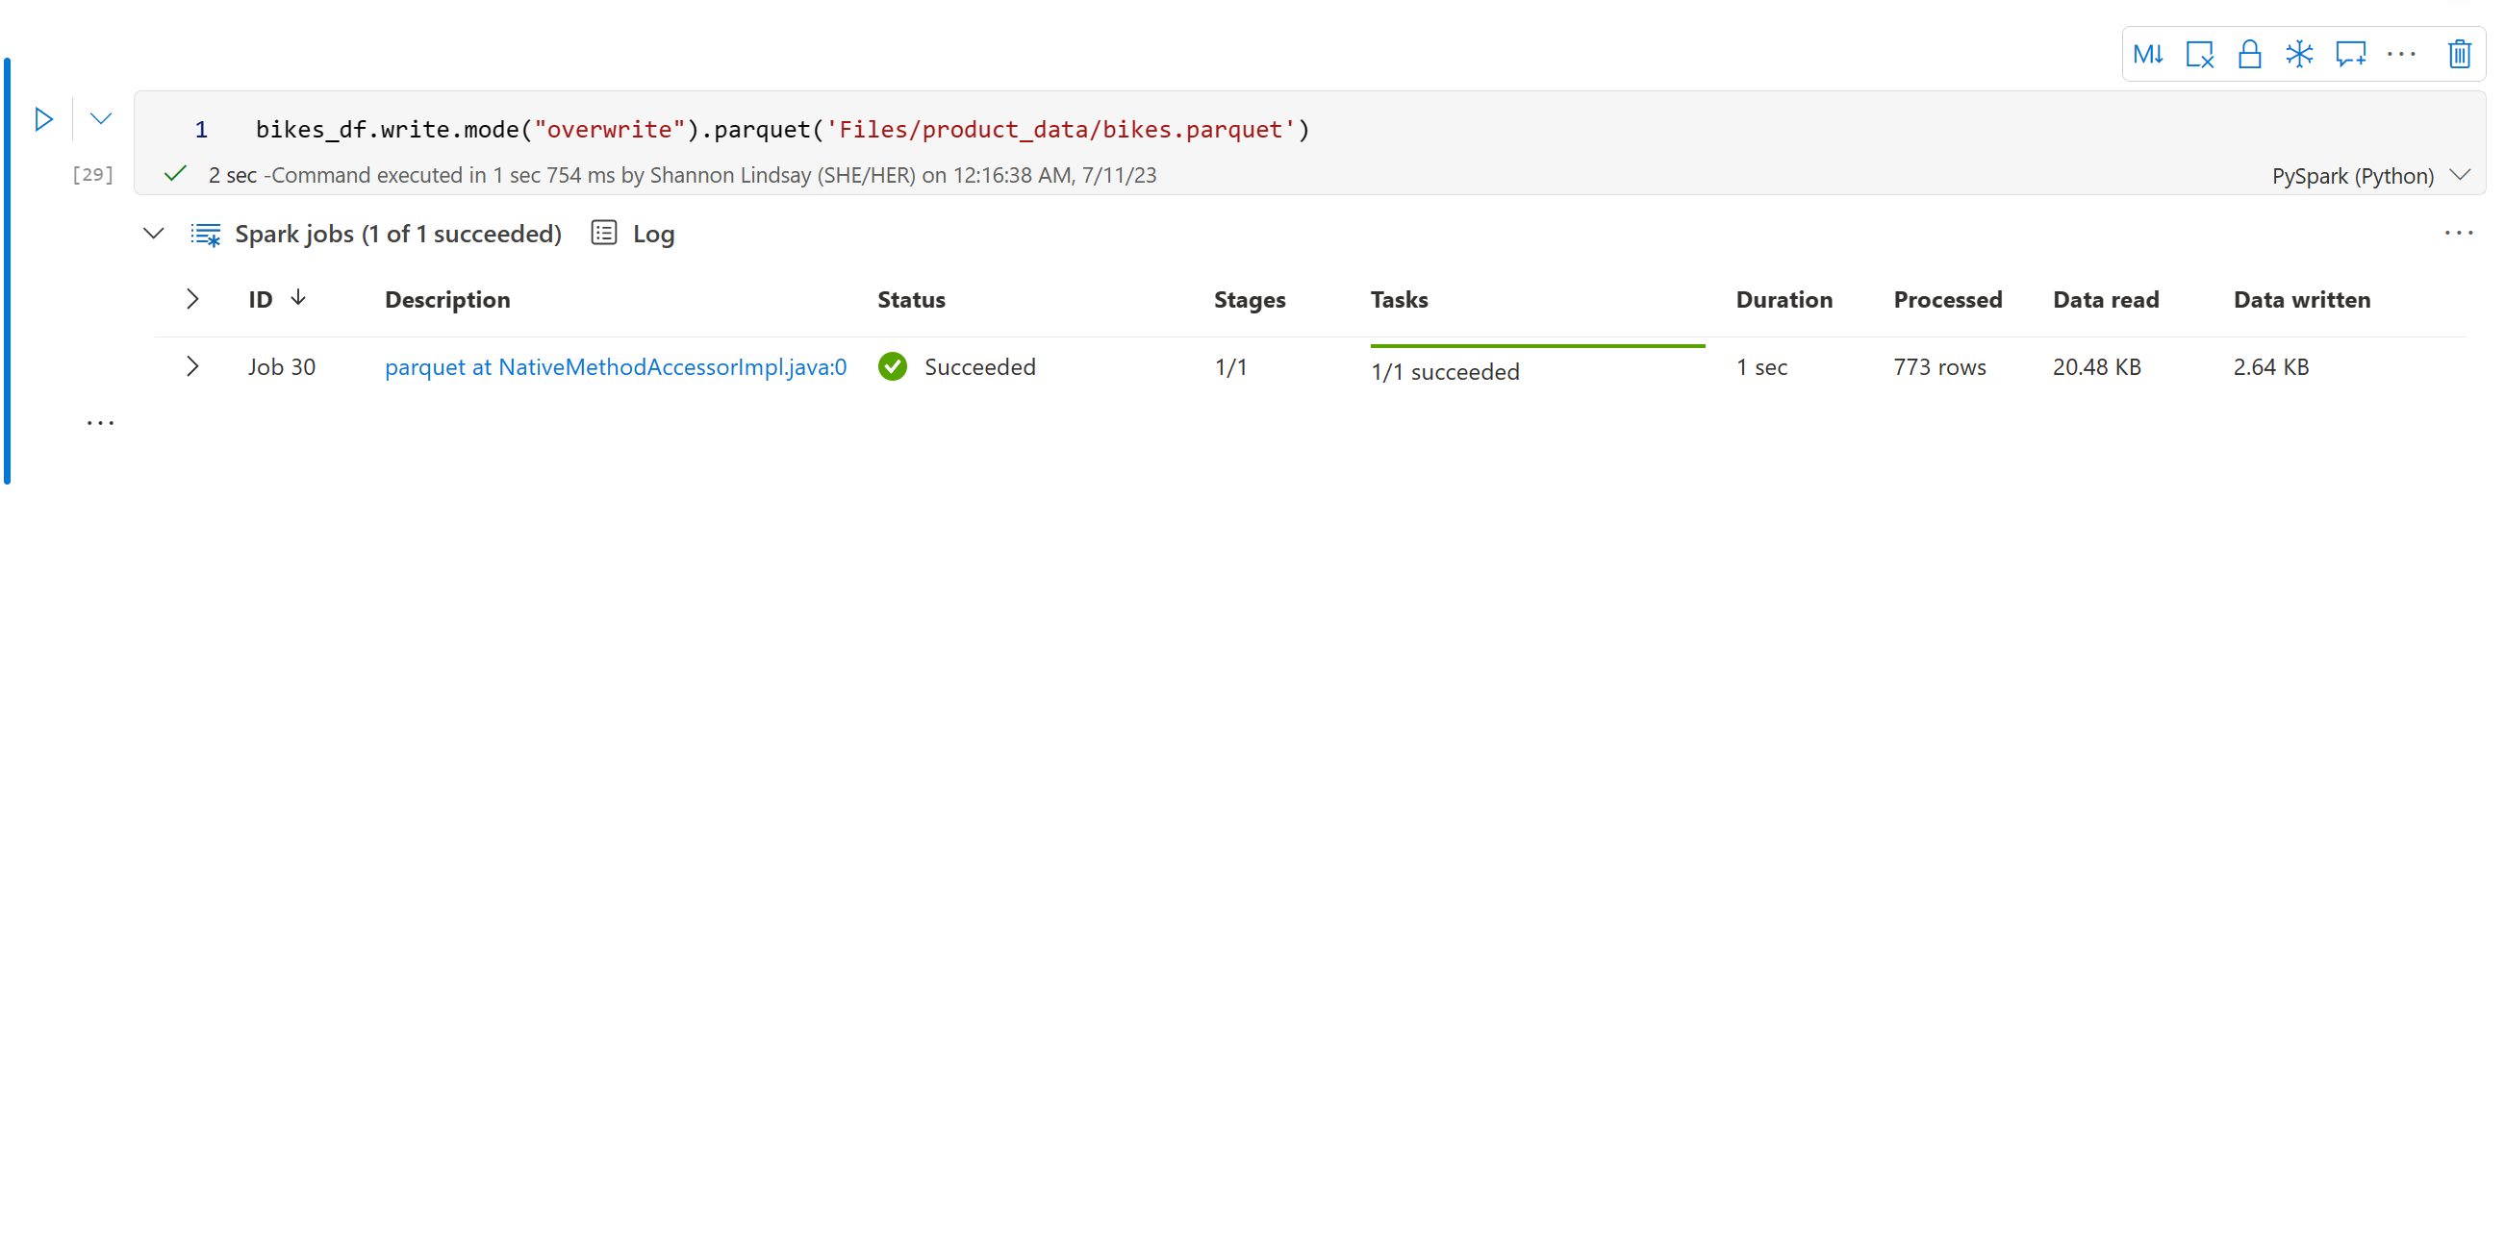
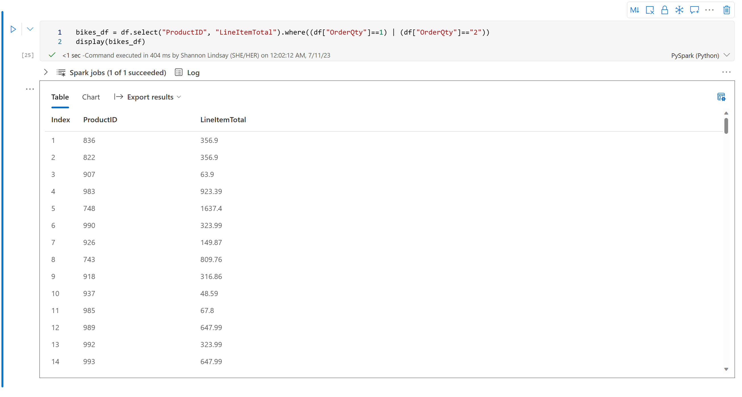
Transform data in a Spark Dataframe
Filter and sort data
Save dataframe for further analysis
Group and aggregate data
Chain methods together
Notes:
This is a build slide.
Dataframe methods are functions or operations provided by a dataframe object that allow you to manipulate and analyze data stored in tabular form. Click You can use the methods of the Dataframe class to filter, sort, group, and otherwise manipulate the data it contains. For example, the code example uses the select method to retrieve the ProductID and LineItemTotal columns from the df dataframe containing product data. Click
You can "chain" methods together to perform a series of manipulations that results in a transformed dataframe. For example, this example code chains the select and where methods to create a new dataframe containing the ProductID and LineItemTotal columns for products with a quantity of 1 or 2.
Click To group and aggregate data, you can use the groupBy method and aggregate functions. For example, the following PySpark code counts the number of products for each quantity of orders. Click
You'll often want to use Spark to transform raw data and save the results for further analysis or downstream processing. The code example saves the dataFrame into a parquet file in the data lake, replacing any existing file of the same name.

Slide 43


Partition the output file
Partition data by one or more columns
Distributes data to improve performance and scalability
data
Year=2020
Year=2021
df.write.partitionBy("Year").mode("overwrite").parquet("/data")
Notes:
Partitioning is an optimization technique that enables Spark to maximize performance across the worker nodes. More performance gains can be achieved when filtering data in queries by eliminating unnecessary disk IO. To save a dataframe as a partitioned set of files, use the partitionBy method when writing the data. The following example saves the dataframe, and partitions the data by Year.
Load partitioned data
When reading partitioned data into a dataframe, you can load data from any folder within the hierarchy by specifying explicit values or wildcards for the partitioned fields.

Slide 44
Work with data using Spark SQL
Use the metastore to define tables and views
# Create a view in the metastore
df.createOrReplaceTempView("products_view")
# Save a dataframe as a new table
df.write.format("delta").saveAsTable("products")
Create external tables
# Create external table
df.write.format("delta").saveAsTable("myexternaltable",path="Files/myexternaltable")
Notes:
The Dataframe API is part of a Spark library named Spark SQL, which enables data analysts to use SQL expressions to query and manipulate data.
Creating database objects in the Spark catalog
The Spark catalog is a metastore for relational data objects such as views and tables. The Spark runtime can use the catalog to seamlessly integrate code written in any Spark-supported language with SQL expressions that may be more natural to some data analysts or developers. One of the simplest ways to make data in a dataframe available for querying in the Spark catalog is to create a temporary view.
A view is temporary, meaning that it's automatically deleted at the end of the current session. You can also create tables that are persisted in the catalog to define a database that can be queried using Spark SQL.
Tables are metadata structures that store their underlying data in the storage location associated with the catalog. In Microsoft Fabric, data for managed tables is stored in the Tables storage location shown in your data lake, and any tables created using Spark are listed there.
You can create an empty table by using the spark.catalog.createTable method, or you can save a dataframe as a table by using its saveAsTable method. Deleting a managed table also deletes its underlying data.
Use the metastore to define tables to create a new table based on delta files in an existing folder, use external tables to save the dataframe as a new set of delta files in a location other than the default table store.

Slide 45
Query data using the Spark SQL API
Use the Spark SQL API in code written in any language to query data in the catalog
# Return data from the products table as a dataframe using PySpark
bikes_df = spark.sql("SELECT ProductID, ProductName, ListPrice \
FROM products \
WHERE Category IN ('Mountain Bikes', 'Road Bikes')")
display(bikes_df)
# Use %%sql magic to query objects in the catalog using native SQL
%%sql
SELECT Category, COUNT(ProductID) AS ProductCount
FROM products
GROUP BY Category
ORDER BY Category
Notes:
This is a build slide.
You can use the Spark SQL API in code written in any language to query data in the catalog.
Click to display PySpark code snippet
The displayed PySpark code uses a SQL query to return data from the products table as a dataframe.
Click to display SQL code snippet
In a notebook, you can also use the %%sql magic to run SQL code that queries objects in the catalog.

Slide 46
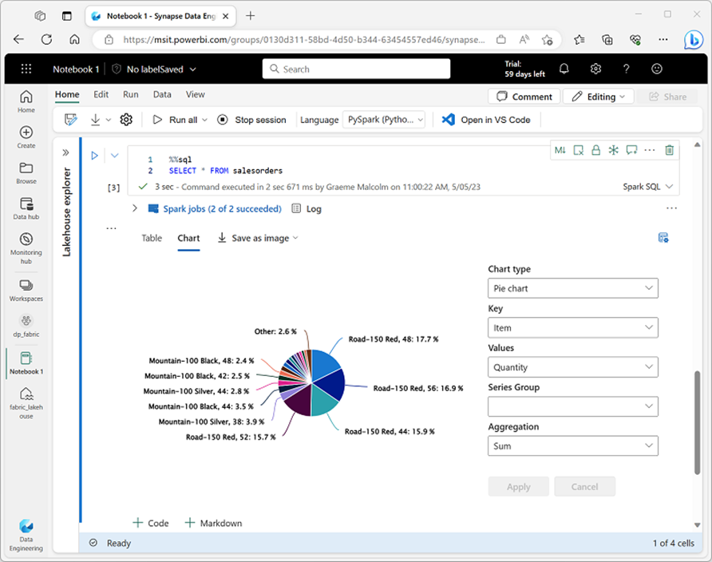
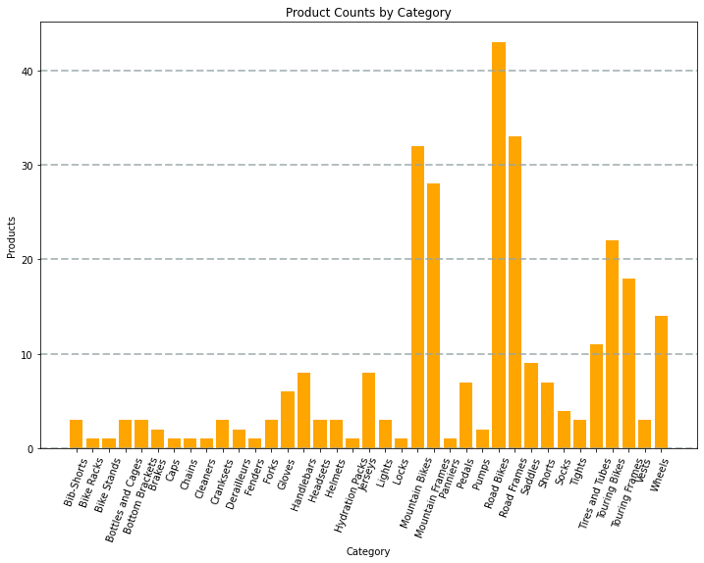
Visualize data
Two ways to visualize data in notebooks:
Use built-in notebook charts
Use graphics packages in code
This example uses Matplotlib
Notes:
This is a build slide.
One of the most intuitive ways to analyze the results of data queries is to visualize them as charts. Notebooks in Microsoft Fabric provide some basic charting capabilities in the user interface, and when that functionality doesn't provide what you need, you can use one of the many Python graphics libraries to create and display data visualizations in the notebook. Click
1. Use built-in notebook charts
When you display a dataframe or run a SQL query in a Spark notebook, the results are displayed under the code cell. By default, results are rendered as a table, but you can also change the results view to a chart and use the chart properties to customize how the chart visualizes the data.
Click
2. Use graphics packages in code
There are many graphics packages that you can use to create data visualizations in code. In particular, Python supports a large selection of packages; most of them built on the base Matplotlib library. The output from a graphics library can be rendered in a notebook, making it easy to combine code to ingest and manipulate data with inline data visualizations and markdown cells to provide commentary.

Slide 47
Exercise
Analyze data with Apache Spark
45 minutes
Notes:
https://aka.ms/mslearn-fabric-spark The estimated time to complete this exercise is 45 minutes.

Slide 48
Knowledge check
1
You want to use Apache Spark to explore data interactively in Microsoft Fabric. What should you create?
A Spark job definition.
A Data Factory pipeline.
A notebook.
2
You need to use Spark to analyze data in a CSV file. What's the simplest way to accomplish this goal?
Load the file into a dataframe.
Import the data into a table in a warehouse.
Convert the data to Parquet format.
3
Which method is used to split the data across folders when saving a dataframe?
splitBy
distributeBy
partitionBy
Notes:
Allow students a few minutes to think about the questions, and then use the animated slide to reveal the correct answers.

Slide 49
Recap
In this section, we covered:
Explored how Apache Spark is integrated in Fabric.
Used Spark in a Fabric notebook to ingest, transform, and load data into a lakehouse.
Worked with and visualized data using PySpark and Spark SQL.

Slide 50
Further reading
Use Apache Spark in Microsoft Fabric
https://aka.ms/fabric-spark
Notes:
Encourage students to review the online material on Microsoft Learn on which this presentation is based.

